Slide 1
SYNChronicity Conference 2020
HIV/HCV Co-Infection Watch 2020 National Monitoring Report
Presenters:
Marcus J. Hopkins, Project Director, Community Access National Network A. Toni Young, Founder & Executive Director, Community Education Group
SYNC2020.org

Slide 2
CONFLICT OF INTEREST DISCLOSURE Marcus J. Hopkins
HIV/HCV Co-Infection Watch Funding Acknowledgements:
The Community Access National Network (CANN) receives funding from the following partners:
AbbVie, Biotechnology Industry Organization, Gilead Sciences, GlaxoSmithKline, Janssen, Merck, PhRMA, Quest Diagnostics, Ramsell Holding Corporation, ViiV Healthcare, and Walgreens
The Fifth Annual HIV/HCV Co-Infection Watch 2020 National Monitoring Report Institute at SYNC 2020 is brought to you by generous donations from:
AbbVie & Merck
SYNC2020.org
SYNC2020.org

Slide 3
HIV/HCV Co-infection watch Background
Launched in January 2015
Quarterly summary on relevant data on co-infection of human immunodeficiency virus (HIV) and hepatitis C (HCV)
Initially, limited focus to:
AIDS Drug Assistance Programs
Medicaid
Latest News related to HIV/HCV and Co-Infection
Subsequently, expanded focus on:
Veterans
Patient Assistance Programs (PAPs)
Harm Reduction
Regional Trends
Incarcerated Populations

Slide 4
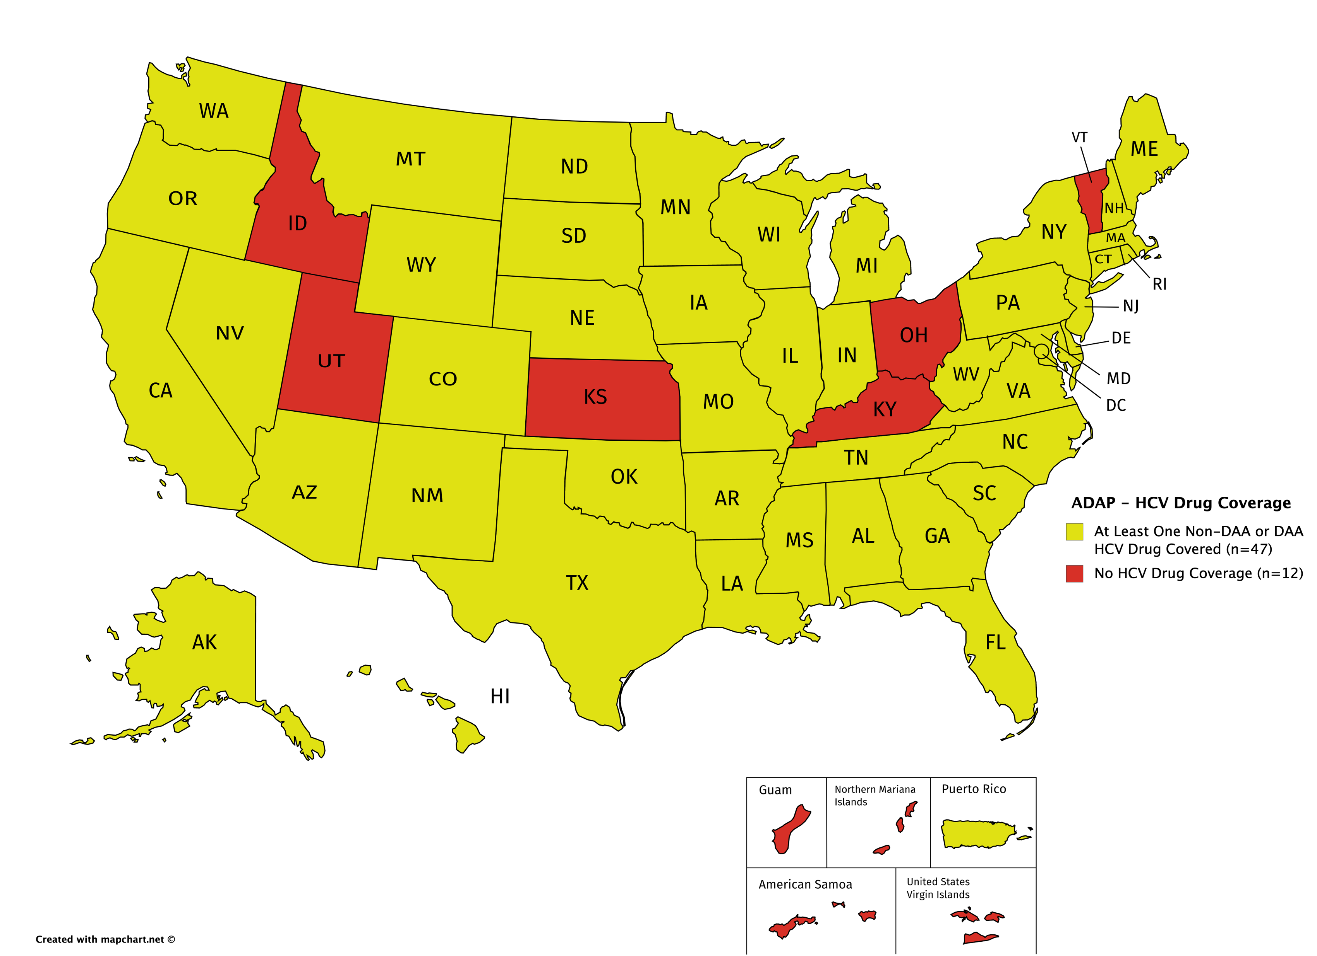
HCV Drug Coverage in state ADAP programs
Only 8 state ADAP program offer no coverage for Direct-Acting Antivirals (DAAs)
AK & SC cover only ribavirin and/or pegylated interferon
ID, KS, KY, OH, UT, & VT offer no HCV drug coverage, whatsoever

Slide 5
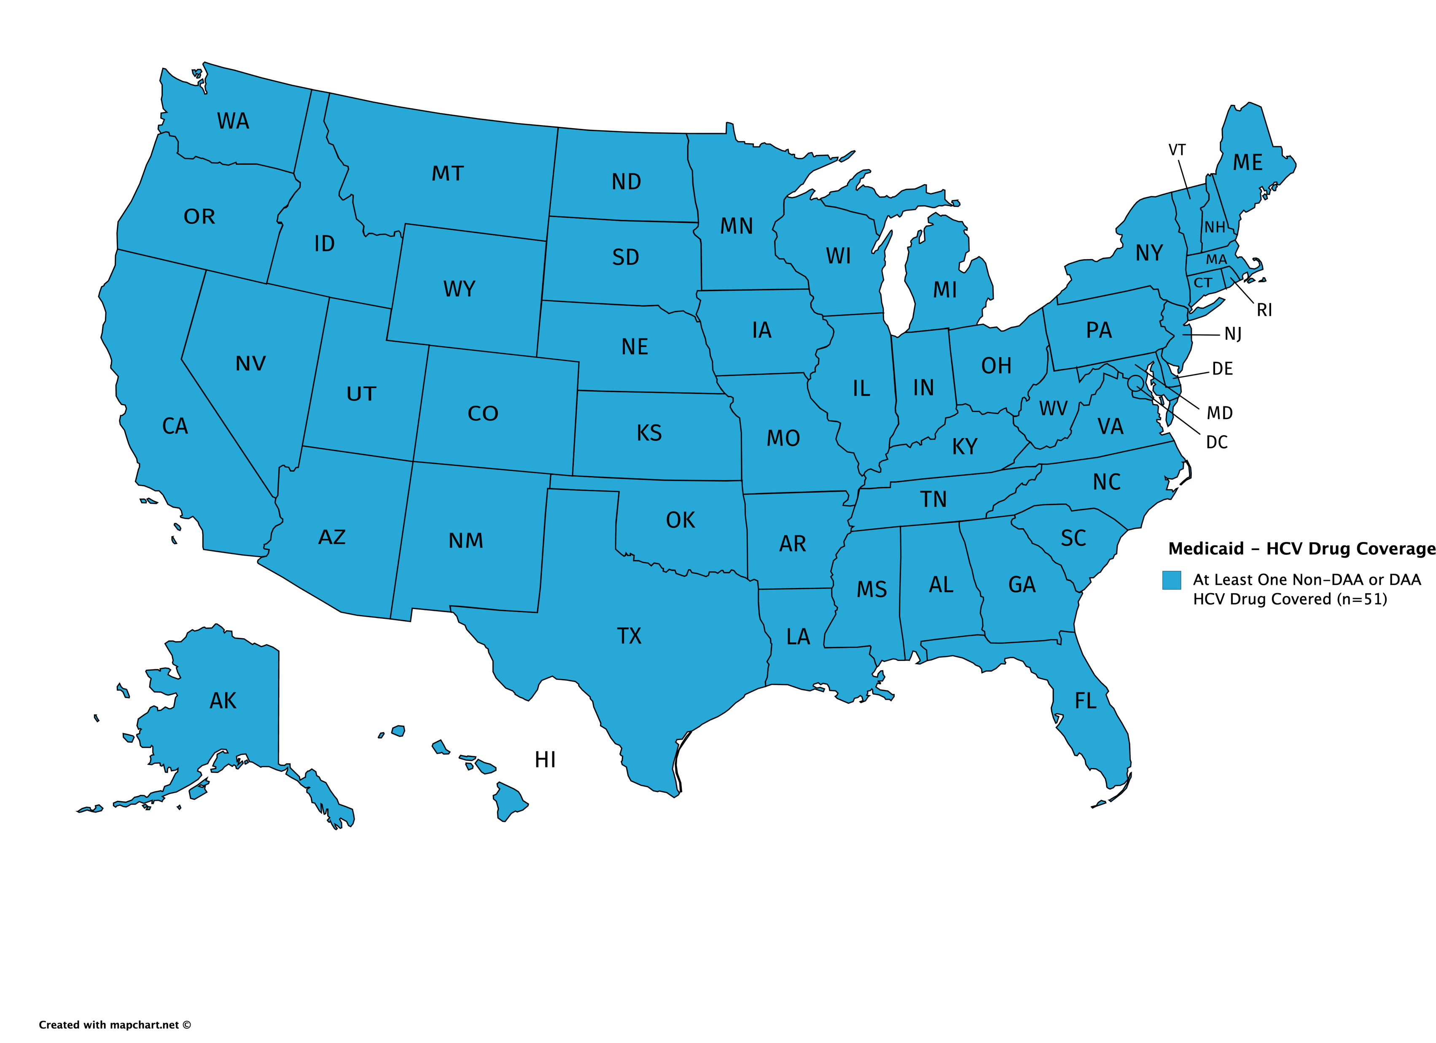
HCV Drug Coverage in state Medicaid programs
All 50 state Medicaid programs and the District of Columbia offer coverage for DAAs
Prior Authorization requirements continue to hinder access to HCV DAAs

Slide 6
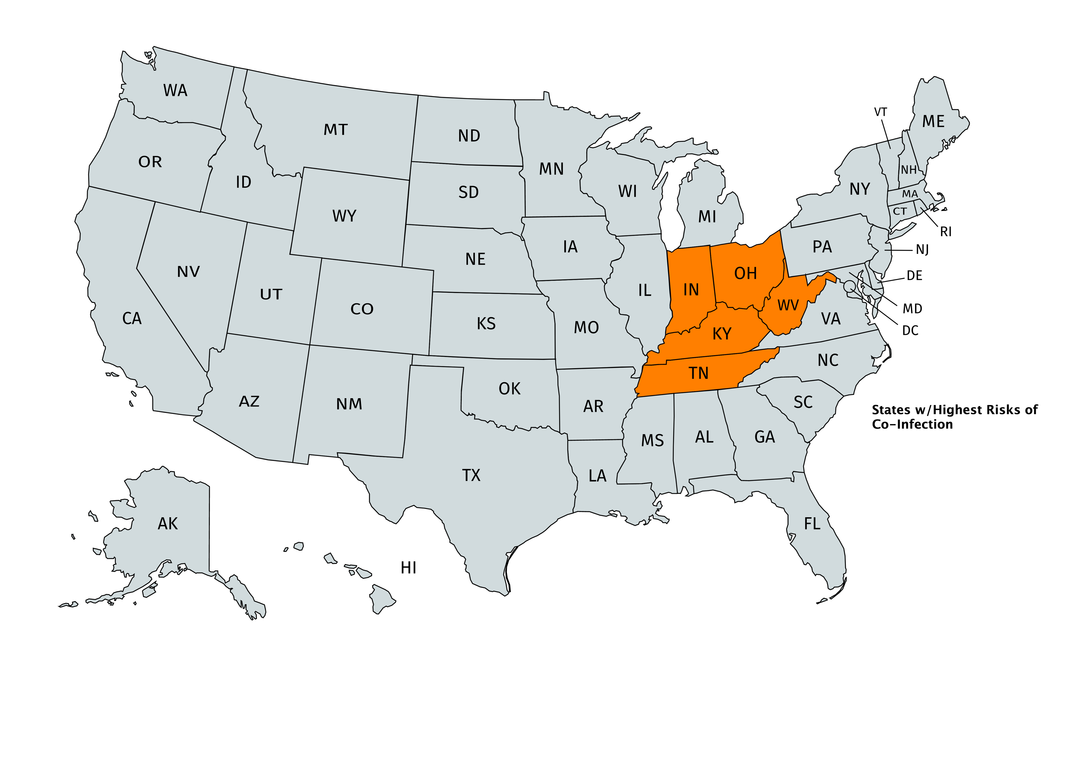
HIV & Viral Hepatitis Co-Infection Risks in five states
IN, KY, OH, TN, & WV
Each state has high levels of Overdose Drug Deaths well above the national rate of 20.7
Each state has high levels of Viral Hepatitis (A, B, or C)
Each state lags in HIV testing in rural areas where Injection Drug Use (IDU) is highly prevalent
Few state and federal resources to build up capacity in rural areas

Slide 7
For more information
For more information on the HIV/HCV Co-Infection Watch, please visit our website:
http://www.tiicann.org/co-infection-watch.html
You can reach Marcus J. Hopkins directly at:
mhopkins@tiicann.org

Slide 8
Panel discussion
Facilitator:
Marissa Tonelli, Director, HealthHCV
Panelists:
Marcus J. Hopkins, Project Director, Community Access National Network
A. Toni Young, Founder & Executive Director, Community Education Group

Slide 9
HIV Free WV

Slide 10
Rural Health Service Providers Network

