Slide 1
PAN Foundation
Connecting Underinsured Patients with the Treatment They Need

Slide 2
Why is Co-Pay Assistance Important?

Slide 3
Importance of Co-Pay Assistance
By the Numbers
Between 25 and 30 million people are underinsured.
Who are the Underinsured?
Individuals who spend more than 10% of their annual income on out-of-pocket medical expenses
Individuals who spend more than 5% of their annual income on deductibles
Individuals whose income is less than 200% of the Federal Poverty Level and medical expenses are greater than 5% of annual income
Seniors who do not have funds or who fall into the “donut hole” (where they have outspent their annual benefit, but have not reached the Medicare catastrophic coverage level)

Slide 4
Trends in Three Key Areas Are Affecting Access and Affordability for Millions of Americans
Trends Impacting Prescription Drugs
Prices are stable or decreasing for generics and increasing for specialty drugs
Many first-in-class drugs and paradigm-shifting treatments are on specialty tiers
Trends Impacting Patients
Exposed to increased cost sharing in both commercial and Part D plans
Decreased access to treatment → greater demand for assistance
Trends Impacting the Patient Assistance Safety Net
Growing difficulty securing external support and donations with increased scrutiny
Public confusion concerning difference between coupon programs and charitable assistance organizations

Slide 5
The Average Annual Price of Treatment Almost Tripled Between 2006 and 2015

Slide 6
The Number of Patients Using Expensive Drugs Has Grown

Slide 7
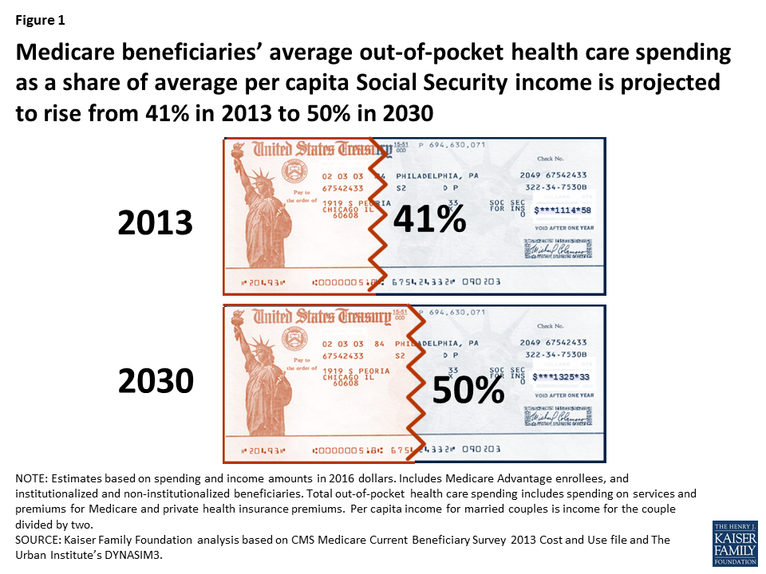
Out-of-Pocket Costs Are Increasing as a Share of Income

Slide 8
Many Seriously Ill Patients Need Help with Out-of-Pocket Costs
Source: PAN Foundation Patient Survey, September 1-29, 2017, N=1,897.

Slide 9
Most Out-of-Pocket Costs Hit Patients Early In the Year
Source: Doshi et al: Am J Manag Care. 2017;23(3 Suppl):S39-S45

Slide 10
What Does the Future Hold?
Cost-sharing is increasing, especially for the sickest patients
The need for patient assistance—particularly for Medicare beneficiaries— exceeds the available charitable assistance
For commercially insured patients, there is growing pressure on drug coupon and copay card programs
Regulatory and payer restrictions on the use of coupons
Co-pay accumulator programs shift costs to patients
Patient assistance programs are under increased scrutiny

Slide 11
What is the PAN Foundation?

Slide 12
What is the PAN Foundation?
We are a nonprofit dedicated to helping underinsured people with life-threatening, chronic and rare diseases get the medications and treatment they need by paying for their out-of-pocket costs and advocating for improved access and affordability.
Types of Assistance Available:
Co-pay Assistance (includes deductible and coinsurance assistance)
Premium
Travel

Slide 13
Who Qualifies for Assistance?
Patient must be getting treatment for the disease named in the program to which he or she is applying.
1
Patient must have health insurance and insurance must cover the qualifying medication for which they seek assistance.
2
3
The medication must directly treat the disease.
Patient's income must fall at or below 400% or 500% of the Federal Poverty Guidelines, depending on fund-specific guidelines.
4
Patient must reside and receive treatment in the United States. U.S. citizenship is not a requirement.
5

Slide 14
What Information Do I Need to Apply?
Patient demographics
Diagnosis and medication name
Insurance information
Income information
Physician information

Slide 15
How Can Patients, Providers and Pharmacists Apply?
Submit your application.
Contact PAN by phone or apply online through our portals.
1
PAN will review your application.
PAN will provide an enrollment decision in one minute.
2
You’re enrolled!
The patient, provider or pharmacist can begin submitting reimbursement requests to PAN.
3
Questions? Call us at 866-316-7263
Notes:
After you have gathered all your information now you are ready to apply for assistance. There are two main ways you can apply with PAN. You can either call us at 866-316-7263 or you can go on one of our self service portals to apply. We have three portals: one for health care providers, one for pharmacies, and one for patients. Each portal is designed with the user group in mind.
On average it takes about 7 minutes to complete an application but once you complete application, PAN will provide an enrollment decision in one minute and follow up with a fax to the provider and mailed letter to the patient advising of enrollment details.

Slide 16
How Long is My Patient’s Grant?
Grant Timeline
Each eligibility period is for 12 months and new patients receive a 3-month lookback period.
PAN must receive and pay claim every 120 days to continue enrollment.
Renew Your Grant
After 12 months, the patient can renew for another year of assistance as needed.
Need Additional Support?
If the patient runs out of funding before their enrollment period ends, they can request a second grant if the disease fund is open.

Slide 17
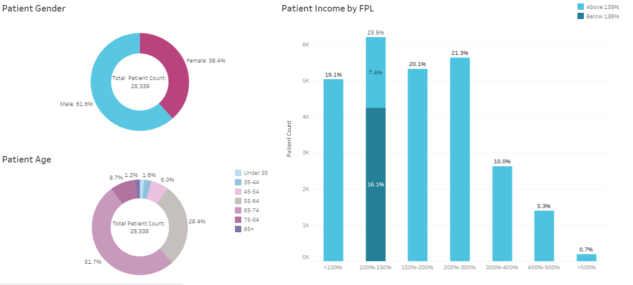
People Enrolled in the Hepatitis C Fund at PAN in the Last 24 Months
Assistance Amount: $7,200

Slide 18
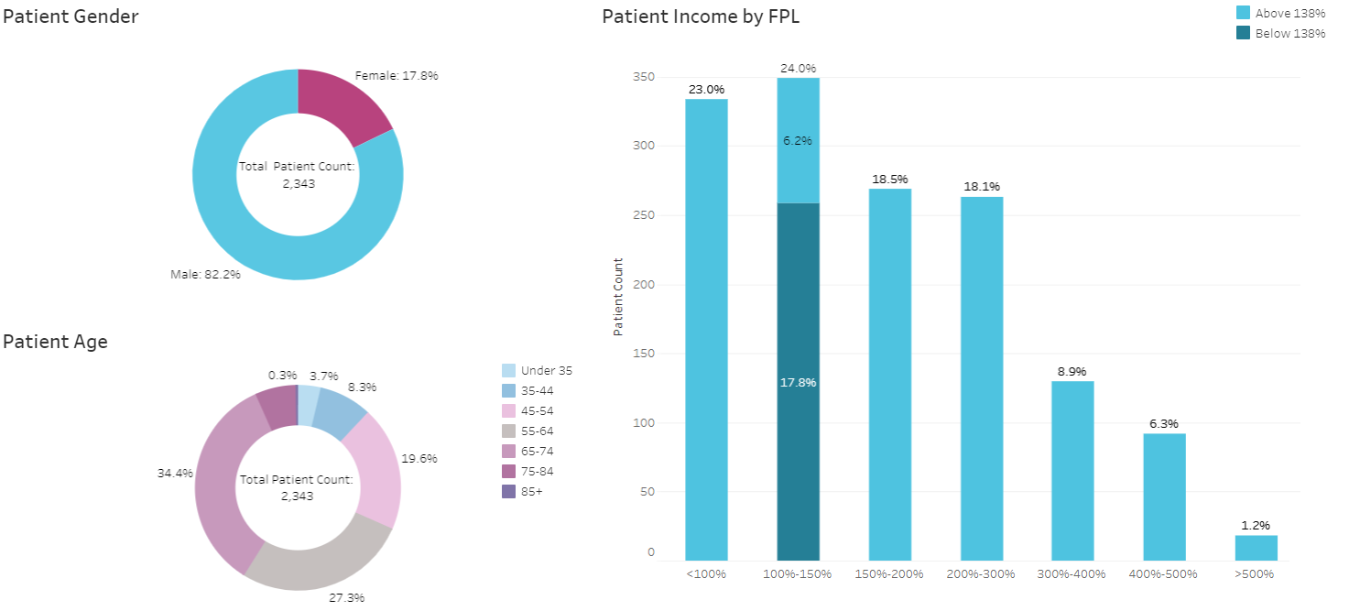
People Enrolled in the HIV Treatment and Prevention Fund at PAN in the Last 24 Months
Assistance Amount: $3,600

Slide 19
How to Stay Connected

Slide 20
Refer Your Patients to PAN at www.panapply.org

Slide 21
Advocacy and Support
PAN released an infographic illustrating a Medicare patient’s journey searching for financial assistance.
PAN joined forces with 52 patient advocacy organizations to submit an RFI response regarding the U.S. Department of Health and Human Services Blueprint to Lower Drug Prices and Reduce OOP Costs.
PAN helps thousands of patients every day and it’s important that the information and resources available to them are displayed in a clear, simple and transparent manner. PAN publishes fact sheets to make all information known every step of the way.

Slide 22
Contact Information
Ayesha Azam
Senior Director of Medical Affairs
(202) 347 – 4451
aazam@panfoundation.org

