Slide 1

HIV/HCV Co-Infection Watch:
2018 Annual Monitoring Report
The HIV/HCV Co-Infection Watch is a publication of the Community Access National Network (CANN). It is a patient-centric informational portal serving three primary groups – Patients, Healthcare Providers, and AIDS Service Organizations.
Learn more: http://www.tiicann.org

Slide 2
Background
Launched in January 2015
Monthly summary on relevant data on co-infection of human immunodeficiency virus (HIV) and hepatitis C (HCV)
Initially, limited focus on:
  AIDS Drug Assistance Programs
  Medicaid
  Latest News related to HIV/HCV and Co-Infection
Subsequently, expanded focus on:
  Veterans
  Patient Assistance Programs (PAPs)
  Harm Reduction
  Regional Trends
Future Focus:
  Incarcerated Populations

Slide 3
Background – What’s included
Overview
Findings
AIDS Drug Assistance Programs (ADAPs)
Medicaid Programs
Veterans Administration standards
Patient Assistance Programs (PAPs)
Harm Reduction Programs
Regional Trends
Latest News
Contact Information
Disclaimer
Methodology
References

Slide 4
ADAP HCV DAA Trends: 2015-2018
Coverage Trends
  January 2015:
    States offering Expanded Coverage – 7 (CA, CO, HI, IA, MA, MN, NJ)
    States offering only Basic Coverage – 24
  June 2015:
    States offering Expanded Coverage – 11 (AZ, AR, CA, CO, HI, IA, LA, MA, MN, NJ, SD)
    States offering only Basic Coverage – 24
  January 2016:
    States offering Expanded Coverage – 17 (AZ, AR, CA, CO, DE, HI, IA, ME, MA, MN, NJ, OK, PA, TN, VA, WA, DC)
    States offering only Basic Coverage – 18
  June 2016:
    States offering Expanded Coverage – 26 (AZ, AR, CA, CO, DE, FL, GA, HI, IL, IA, LA, ME, MD, MA, MN, NE, NH, NJ, OK, PA, SD, TN, VA, WA, DC, PR)
    States offering only Basic Coverage - 16
  January 2017:
    States offering Expanded Coverage – 29 (AZ, AR, CA, CO, DE, FL, GA, HI, IL, IA, LA, ME, MD, MA, MN, NE, NH, NJ, NY, OK, OR, PA, SD, TN, VA, WA, WI, DC, PR)
    States offering only Basic Coverage – 13
  August 2017:
    States offering expanded coverage – 33 (AZ, AR, CA, CO, DE, FL, GA, HI, IL, IA, LA, ME, MD, MA, MN, MO, MT, NE, NH, NJ, NY, ND, OK, OR, PA, SD, TN, TX, VA, WA, WI, DC, PR)
    States offering only Basic Coverage – 12

Slide 5
ADAP HCV DAA Trends: 2015-2018
Coverage Trends
  January 2018:
    States offering expanded coverage – 37 (AL, AZ, AR, CA, CO, DE, FL, GA, HI, IL, IA, LA, ME, MD, MA, MN, MO, MT, NE, NH, NJ, NY, NC, ND, OK, OR, PA, RI, SD, TN, TX, VA, WA, WV, Wi, DC, PR)
    States offering only Basic Coverage – 8
  August 2018:
    States offering expanded coverage – 38 (AL, AZ, AR, CA, CO, DE, FL, GA, HI, IL, IA, LA, ME, MD, MA, MI, MN, MO, NE, NH, NJ, NM, NY, NC, ND, OK, OR, PA, RI, SD, TN, TX, VA, WA, WV, Wi, DC, PR) – MT drops expanded coverage
    States offering only Basic Coverage - 6
  States have continued to expand coverage as newer, cheaper HCV DAAs hit the market.
  Expansion picked up marginally
  Zepatier, Harvoni, and Mavyret are the most covered drugs – 33, 30, & 29, respectively
  Olysio exited the market in May 2018; Technivie and Viekira XR will exit in January 2019
  Mavyret has become the fastest adopted drug

Slide 6
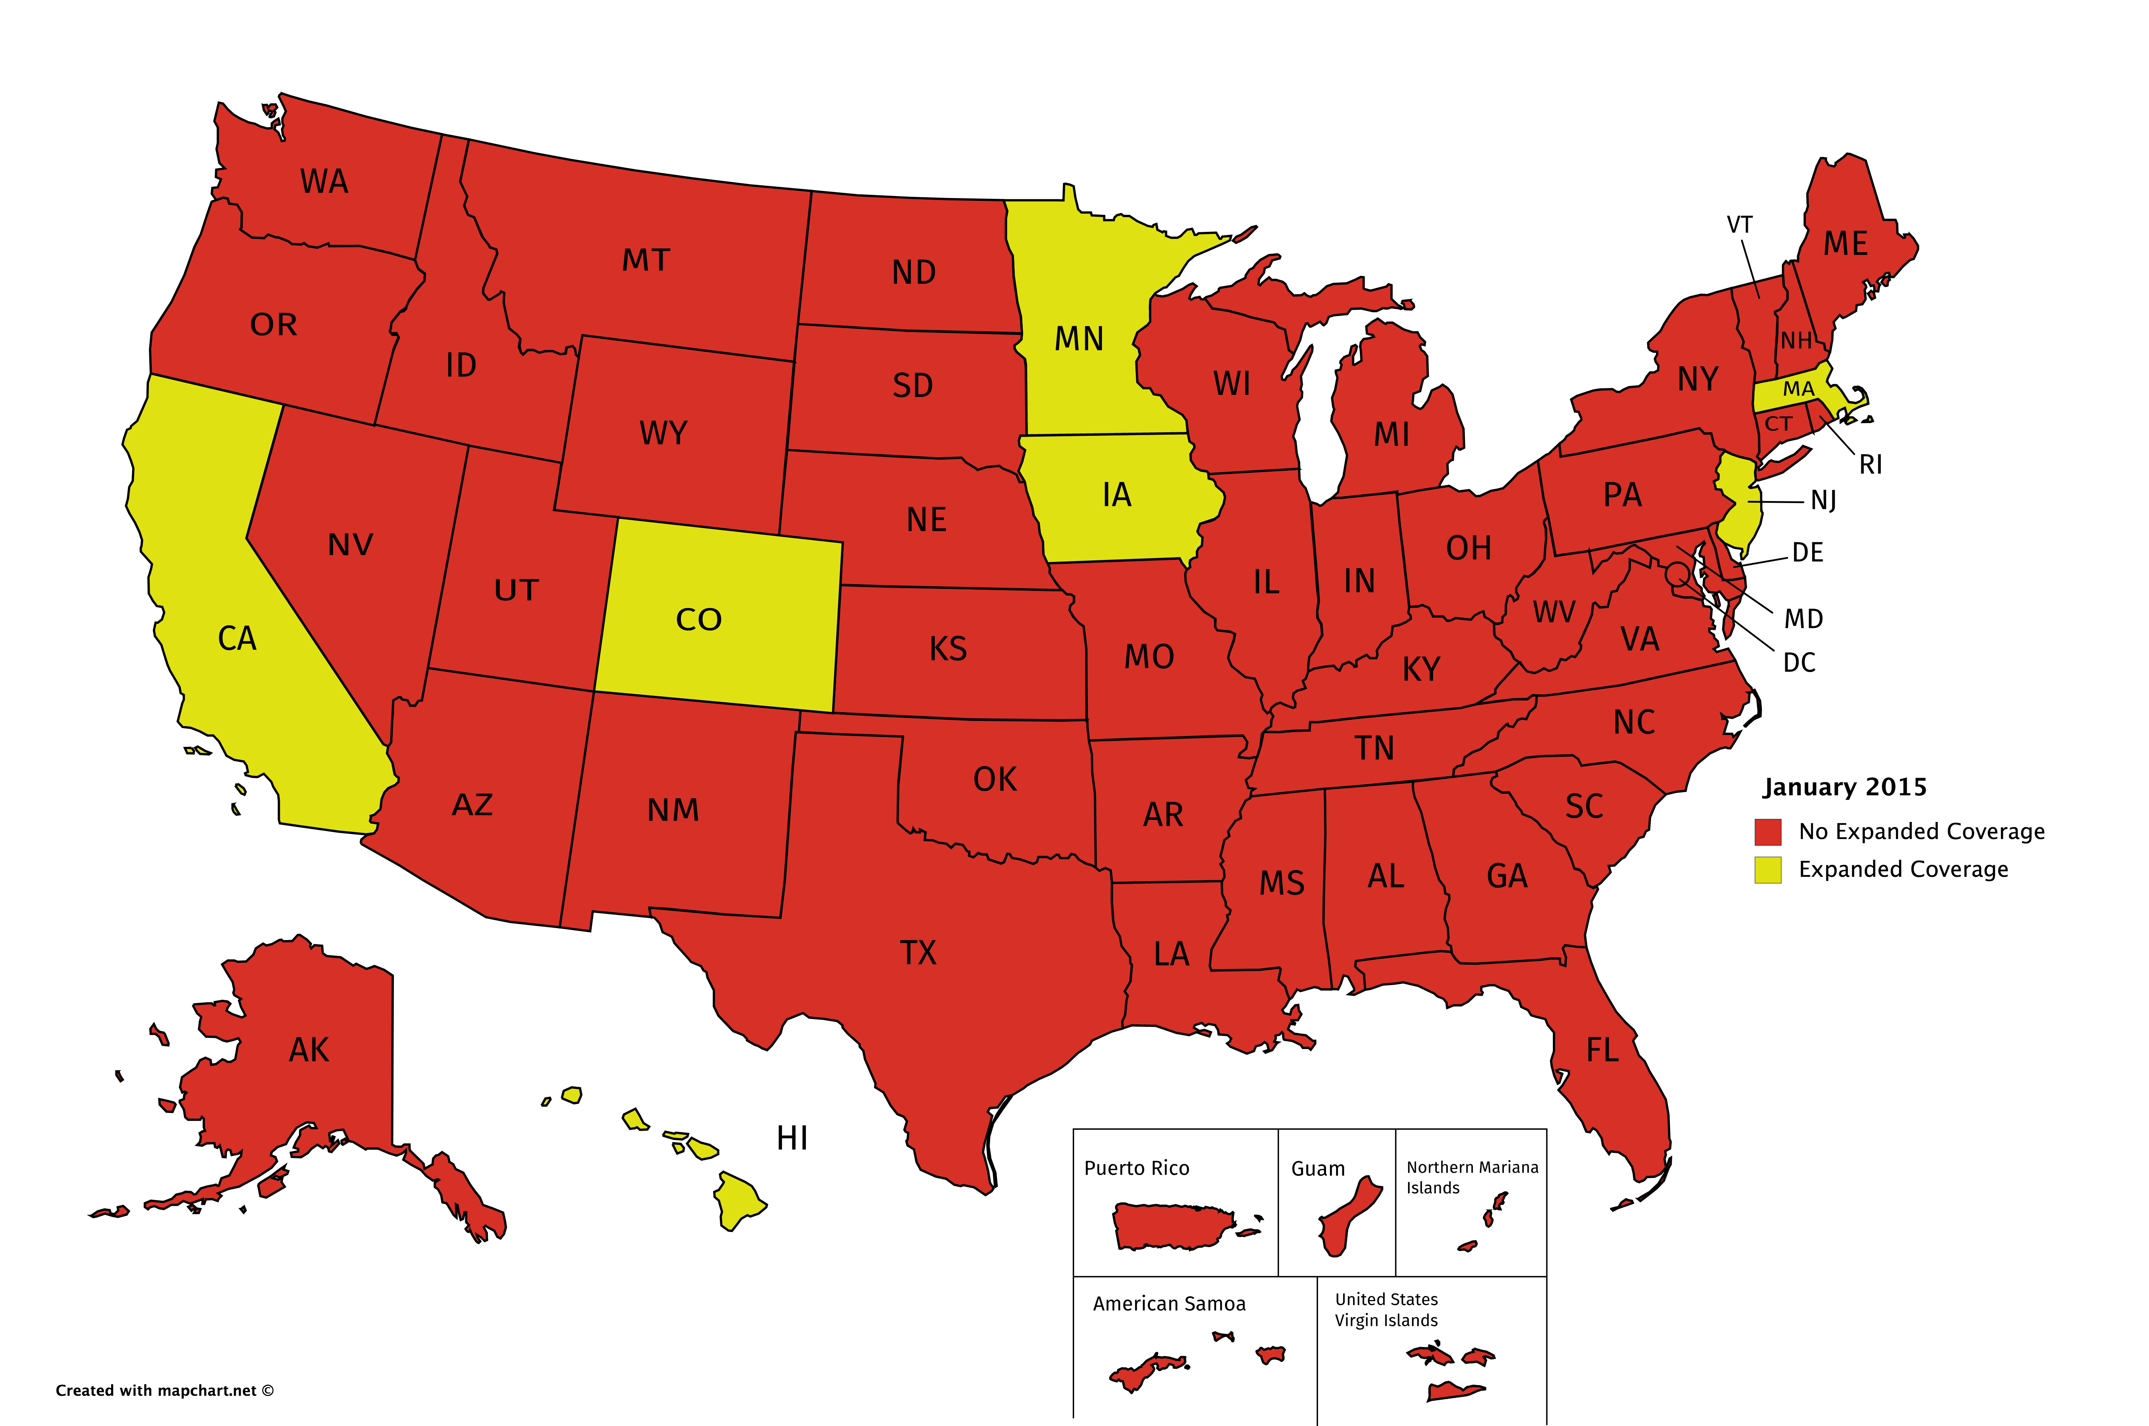
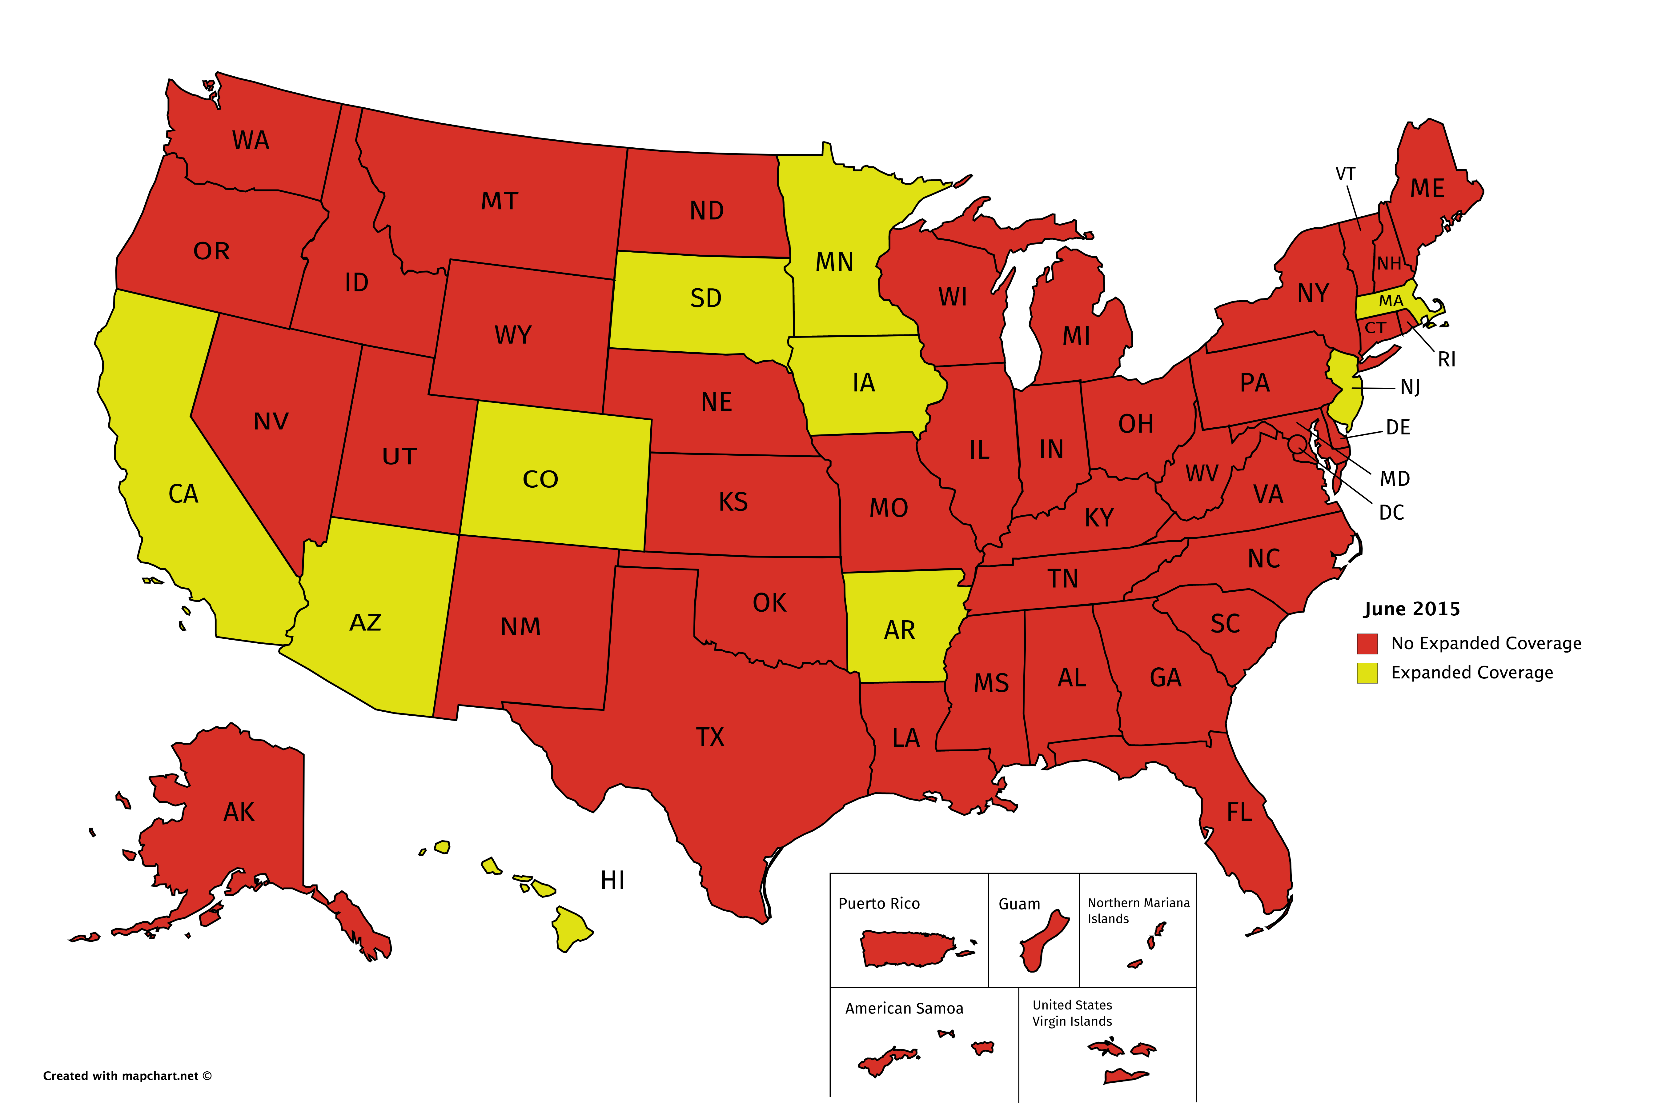
ADAP Expanded Coverage:
January - June 2015

Slide 7
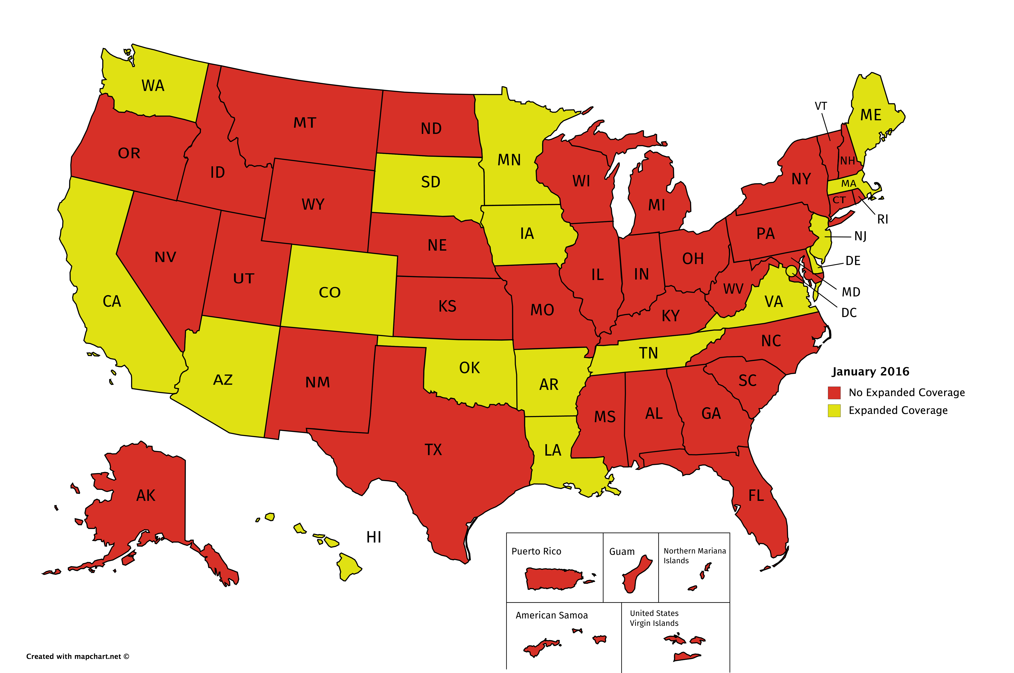
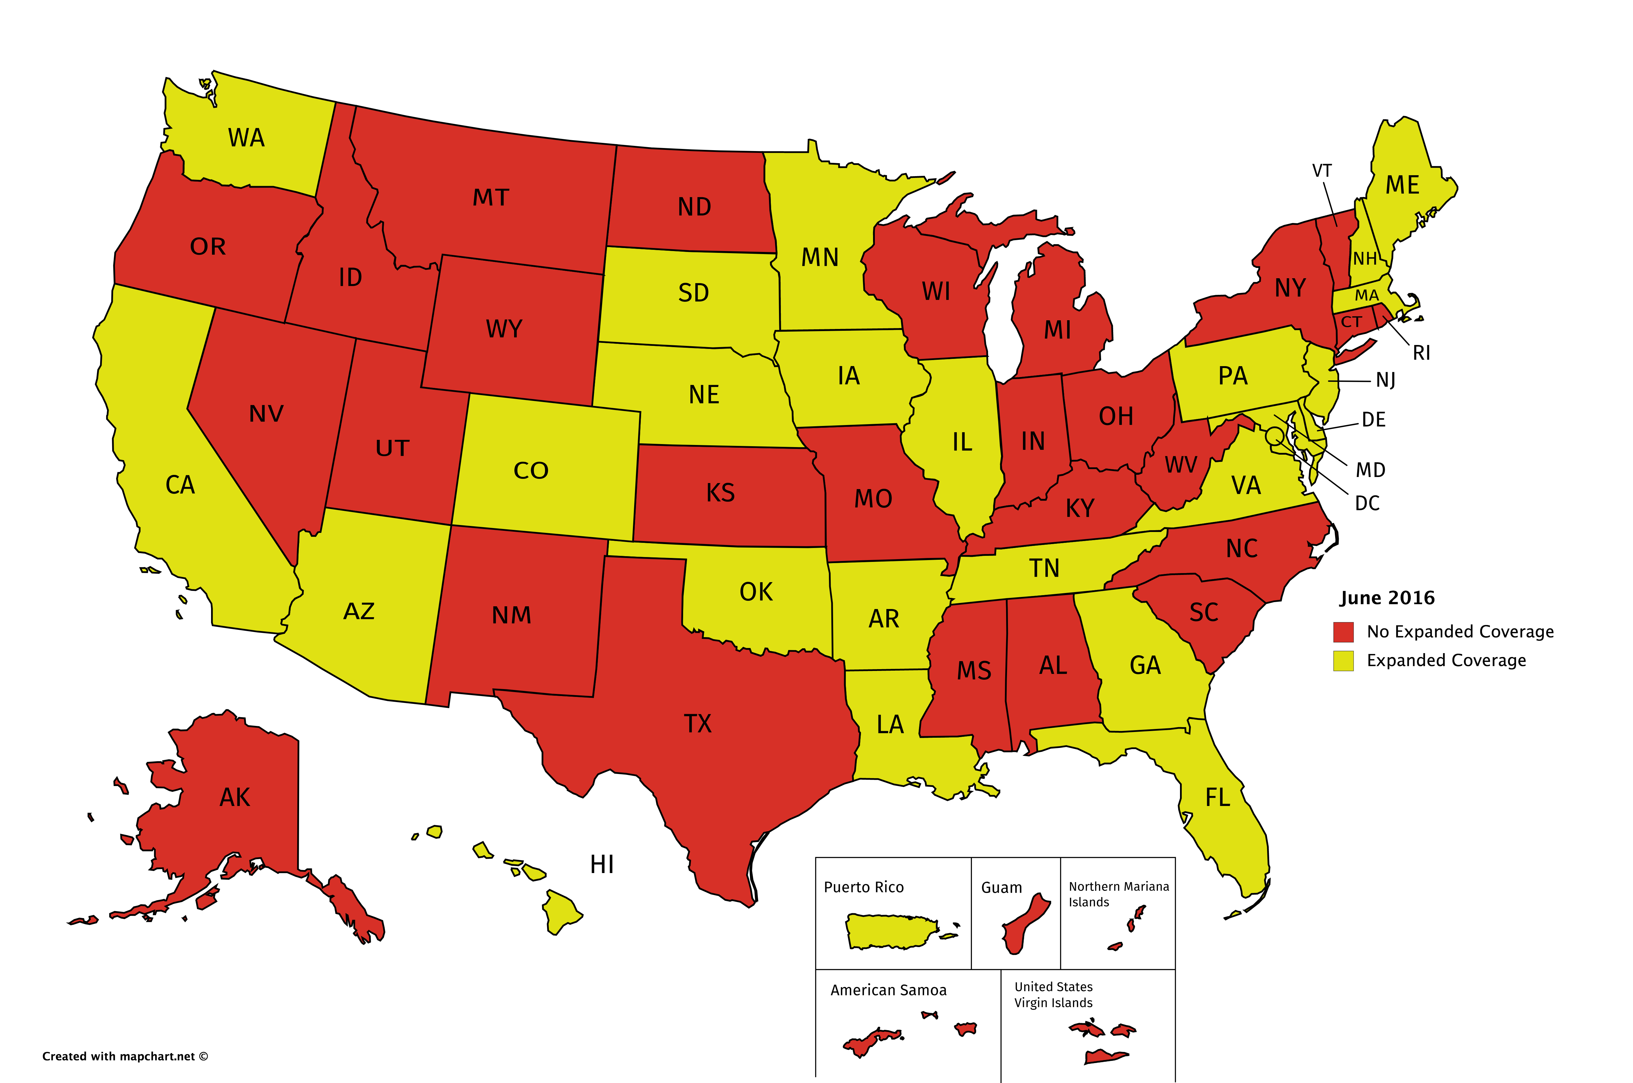
ADAP Expanded Coverage:
January – June 2016

Slide 8
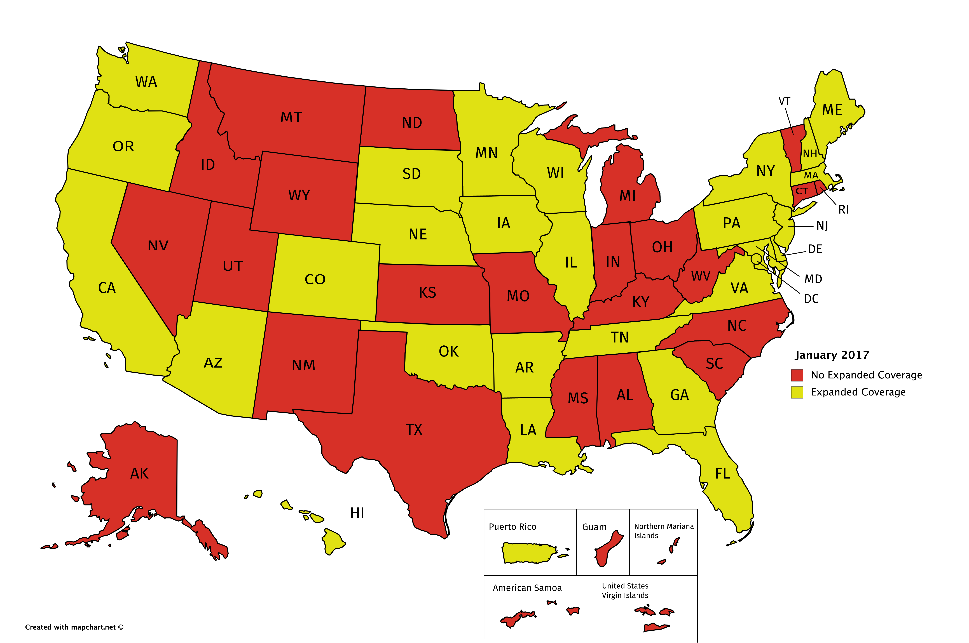
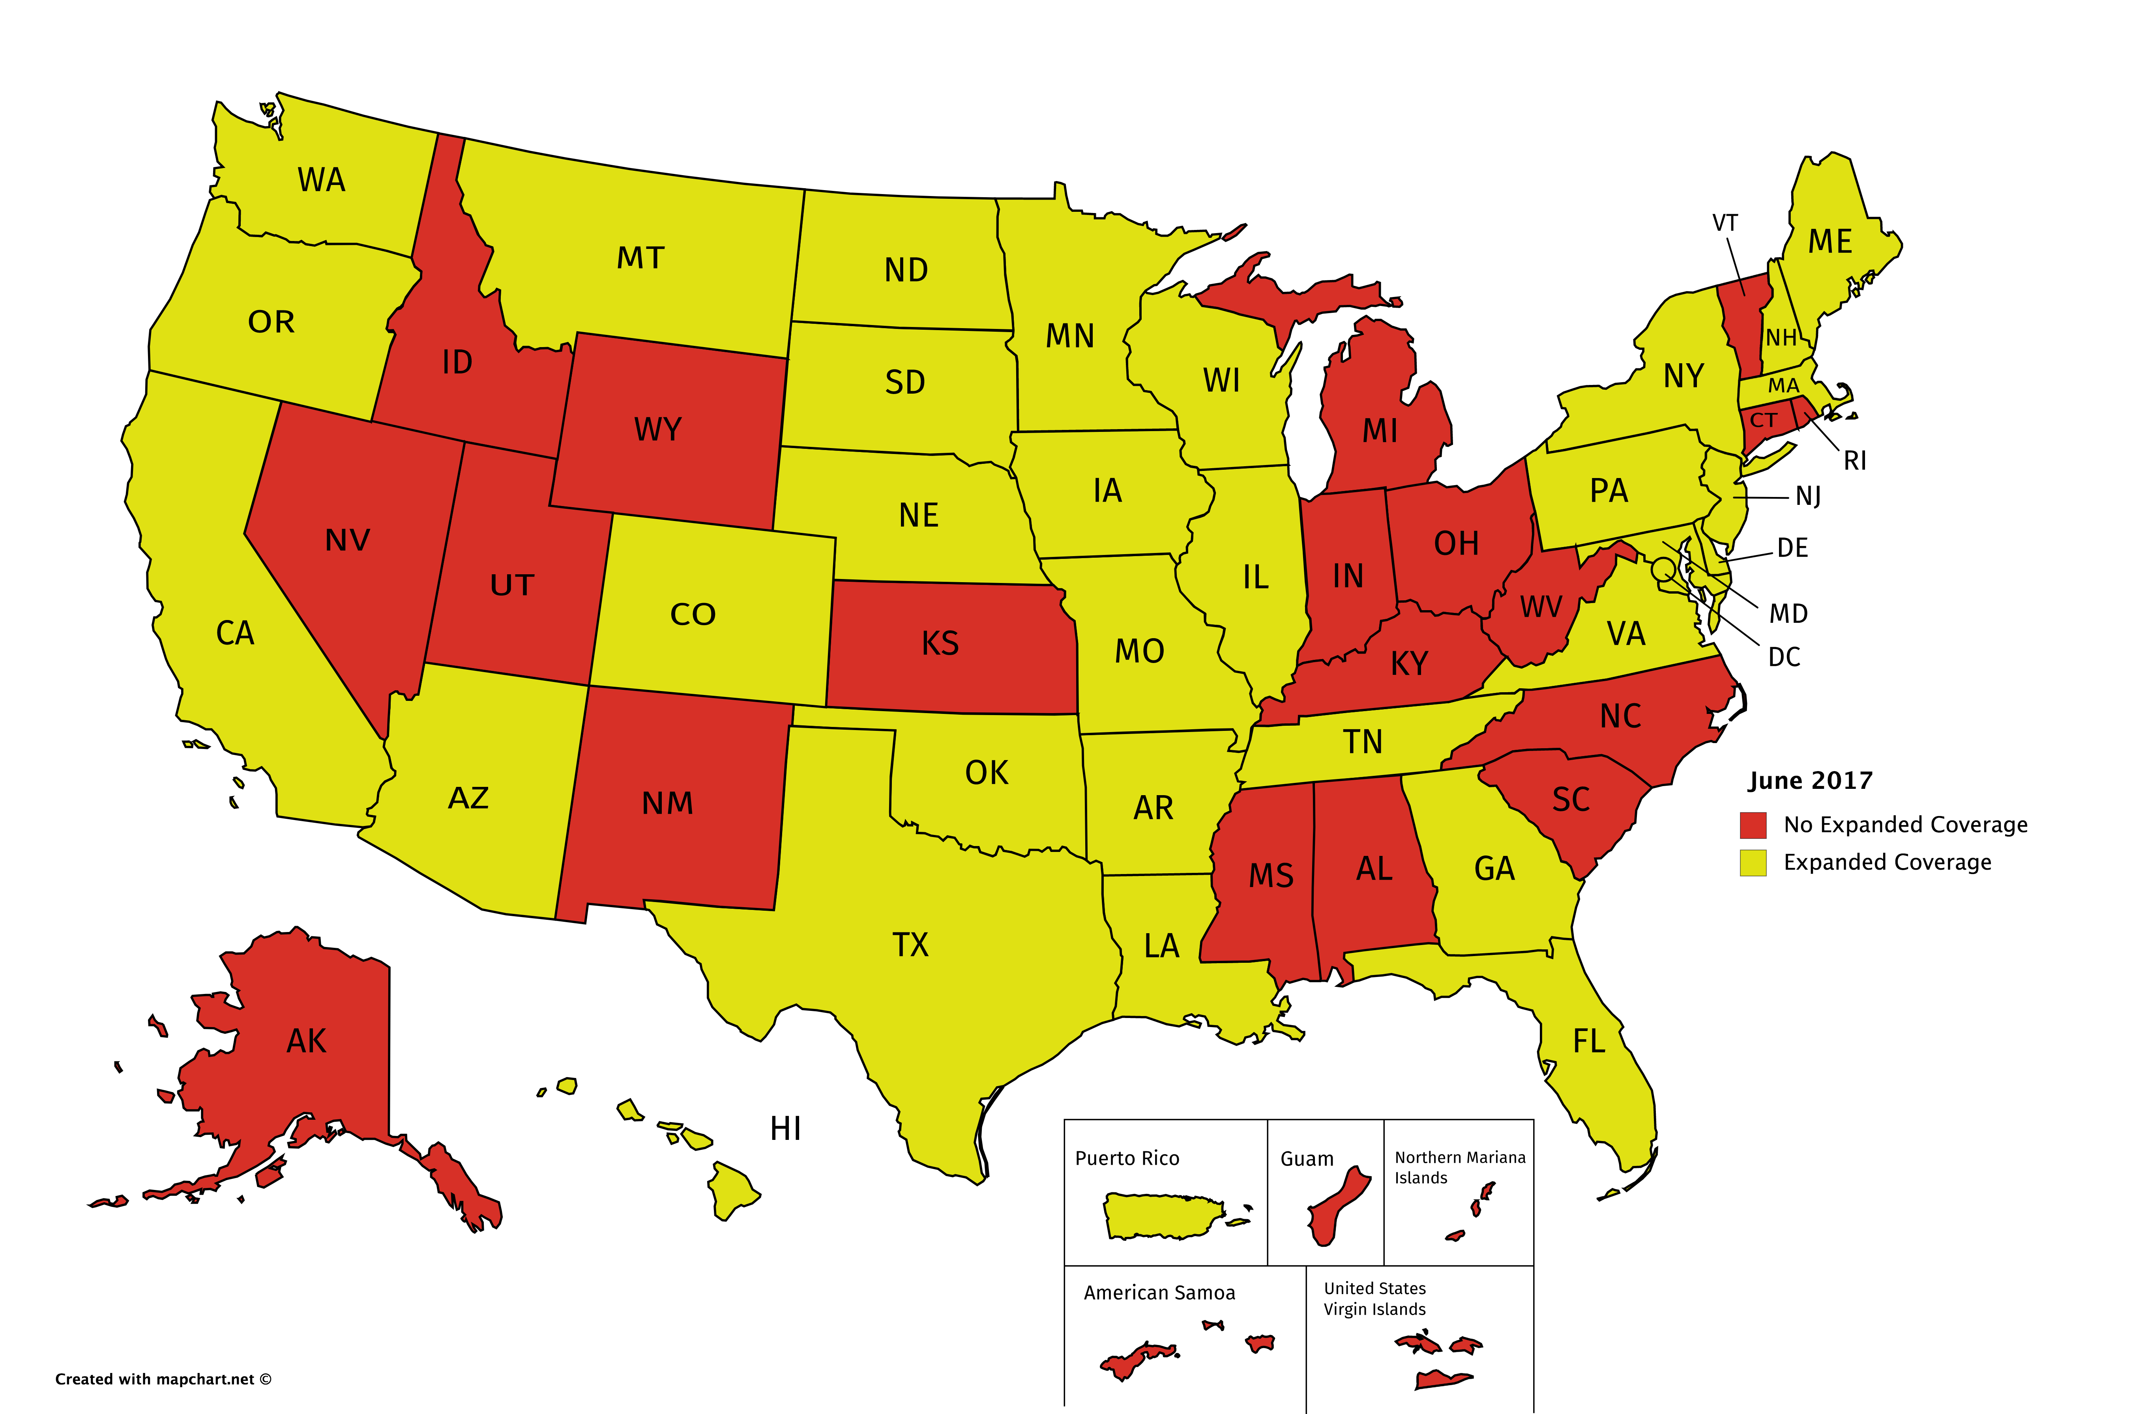
ADAP Expanded Coverage:
January - June 2017

Slide 9
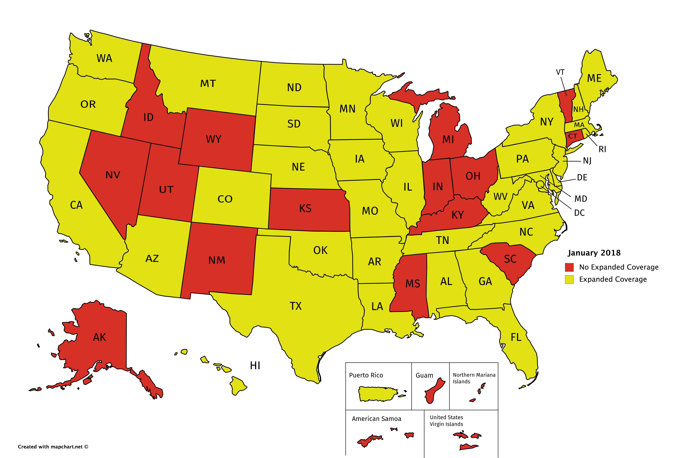
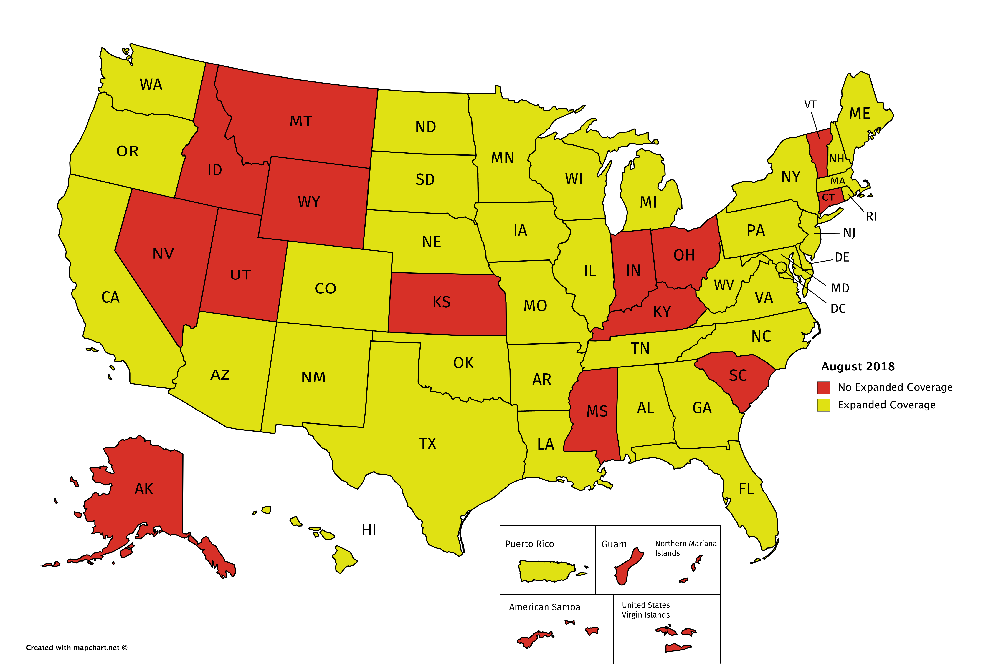
ADAP Expanded Coverage:
January - August 2018

Slide 10
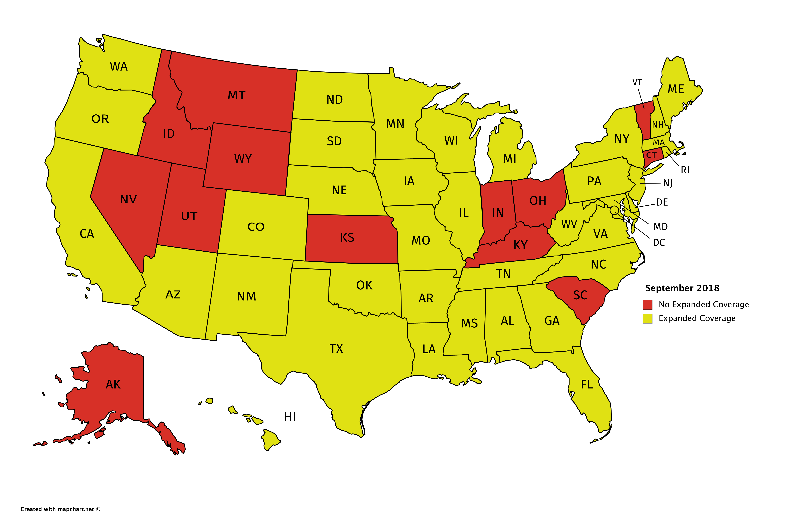
ADAP Expanded Coverage:
September 2018

Slide 11
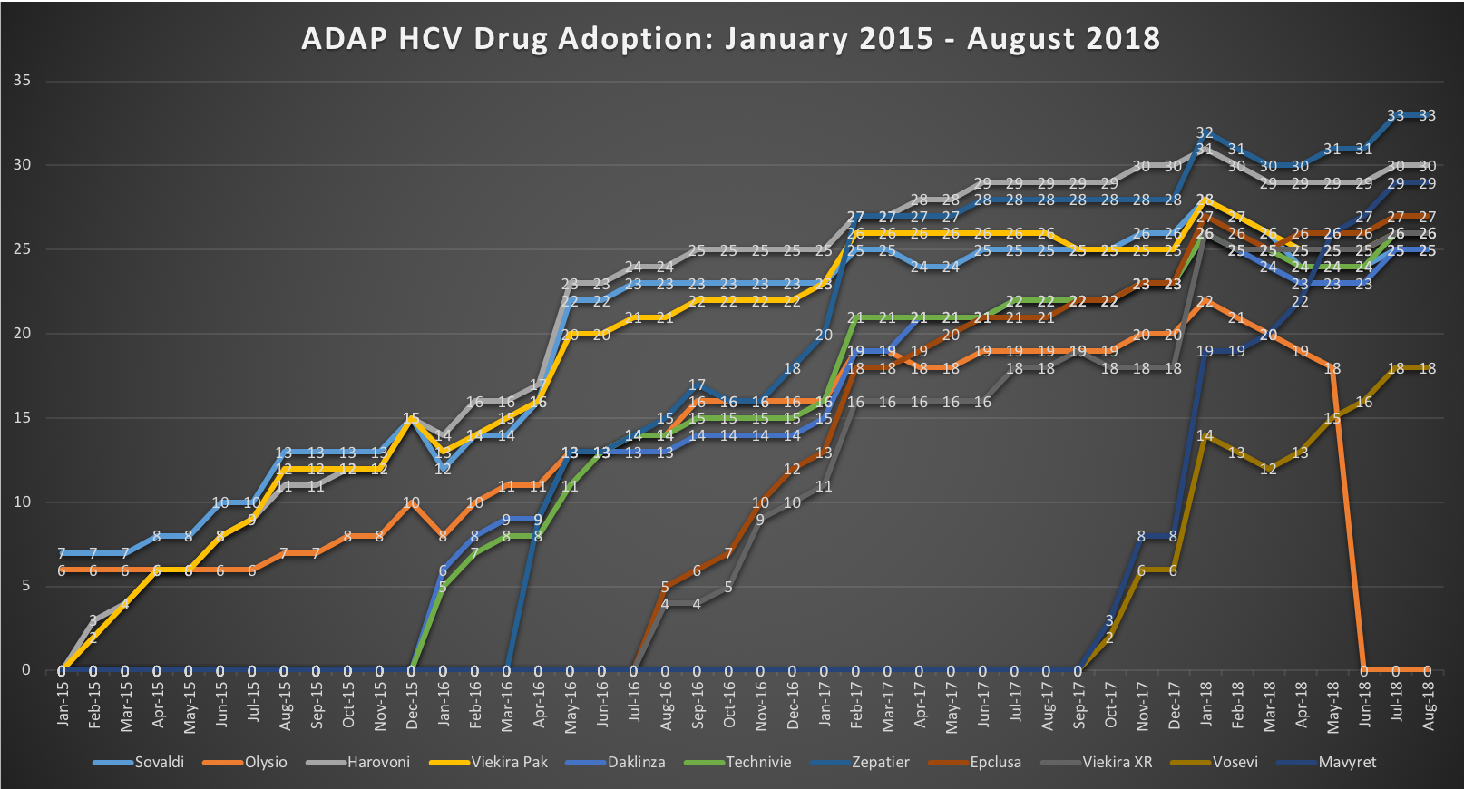
ADAP HCV Drug Utilization:
January 2015 – August 2018

Slide 12
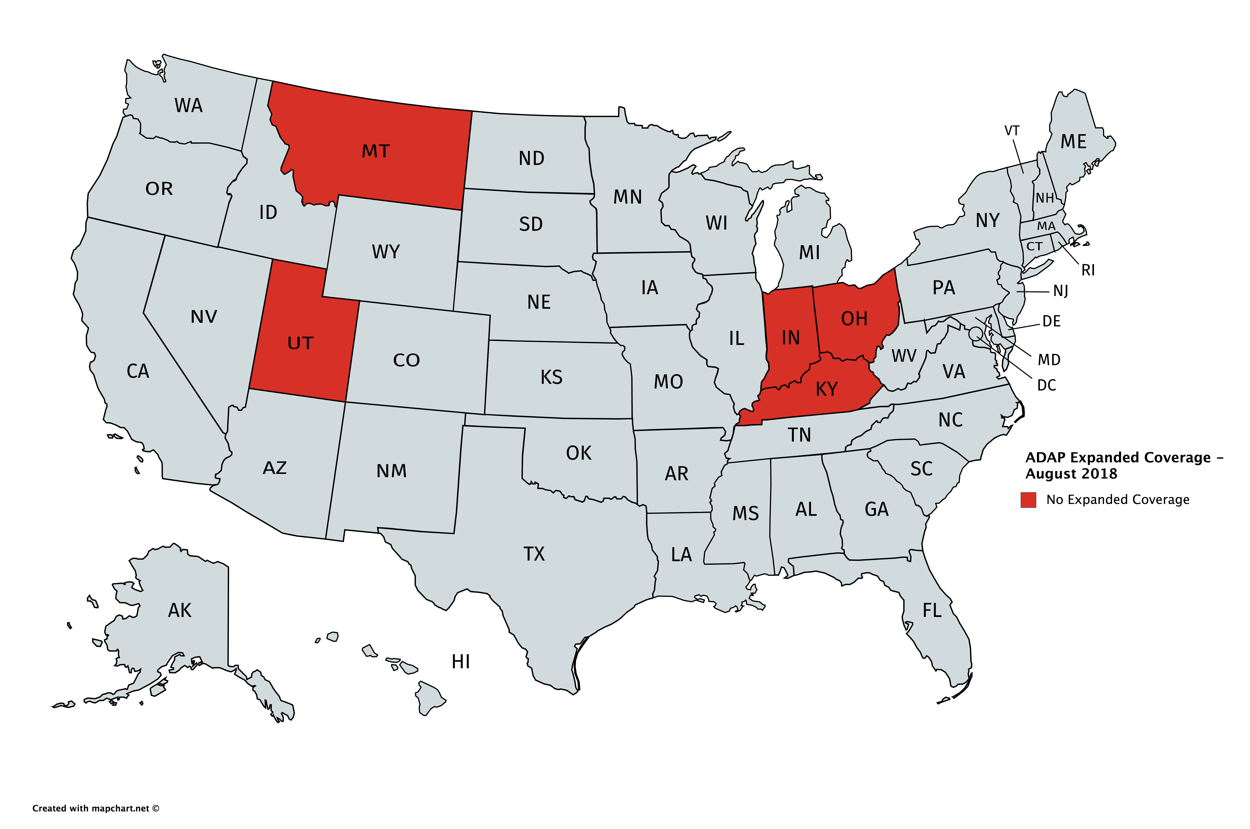
Top Ten HCV Rates Compared to Expanded ADAP HCV Coverage

Slide 13
2015-2018 Trends: Medicaid
Coverage Trends
  January 2015:
    States offering Expanded Coverage – 38
    States offering only Basic Coverage – 12 (AK, AR, CA, CT, FL, KS, MI, NM, ND, RI, SC, TX)
  June 2015:
    States offering Expanded Coverage – 39
    States offering only Basic Coverage – 11 (AR, CA, CT, FL, KS, MI, NM, ND, SC, TX, WA)
  January 2016:
    States offering Expanded Coverage – 49
    States offering only Basic Coverage – 2 (AR, MI)
  June 2016:
    States offering Expanded Coverage – 50
    States offering only Basic Coverage – 1 (AR)
  August 2016 – August 2018:
    States offering Expanded Coverage – 51
    States offering only Basic Coverage – 0
  All states currently offer Expanded Coverage for HCV drugs
  Medicaid programs quicker to adopt HCV drugs than ADAPs
  States with multiple coverage plans are likelier to have plans offering only one or two HCV DAAs

Slide 14
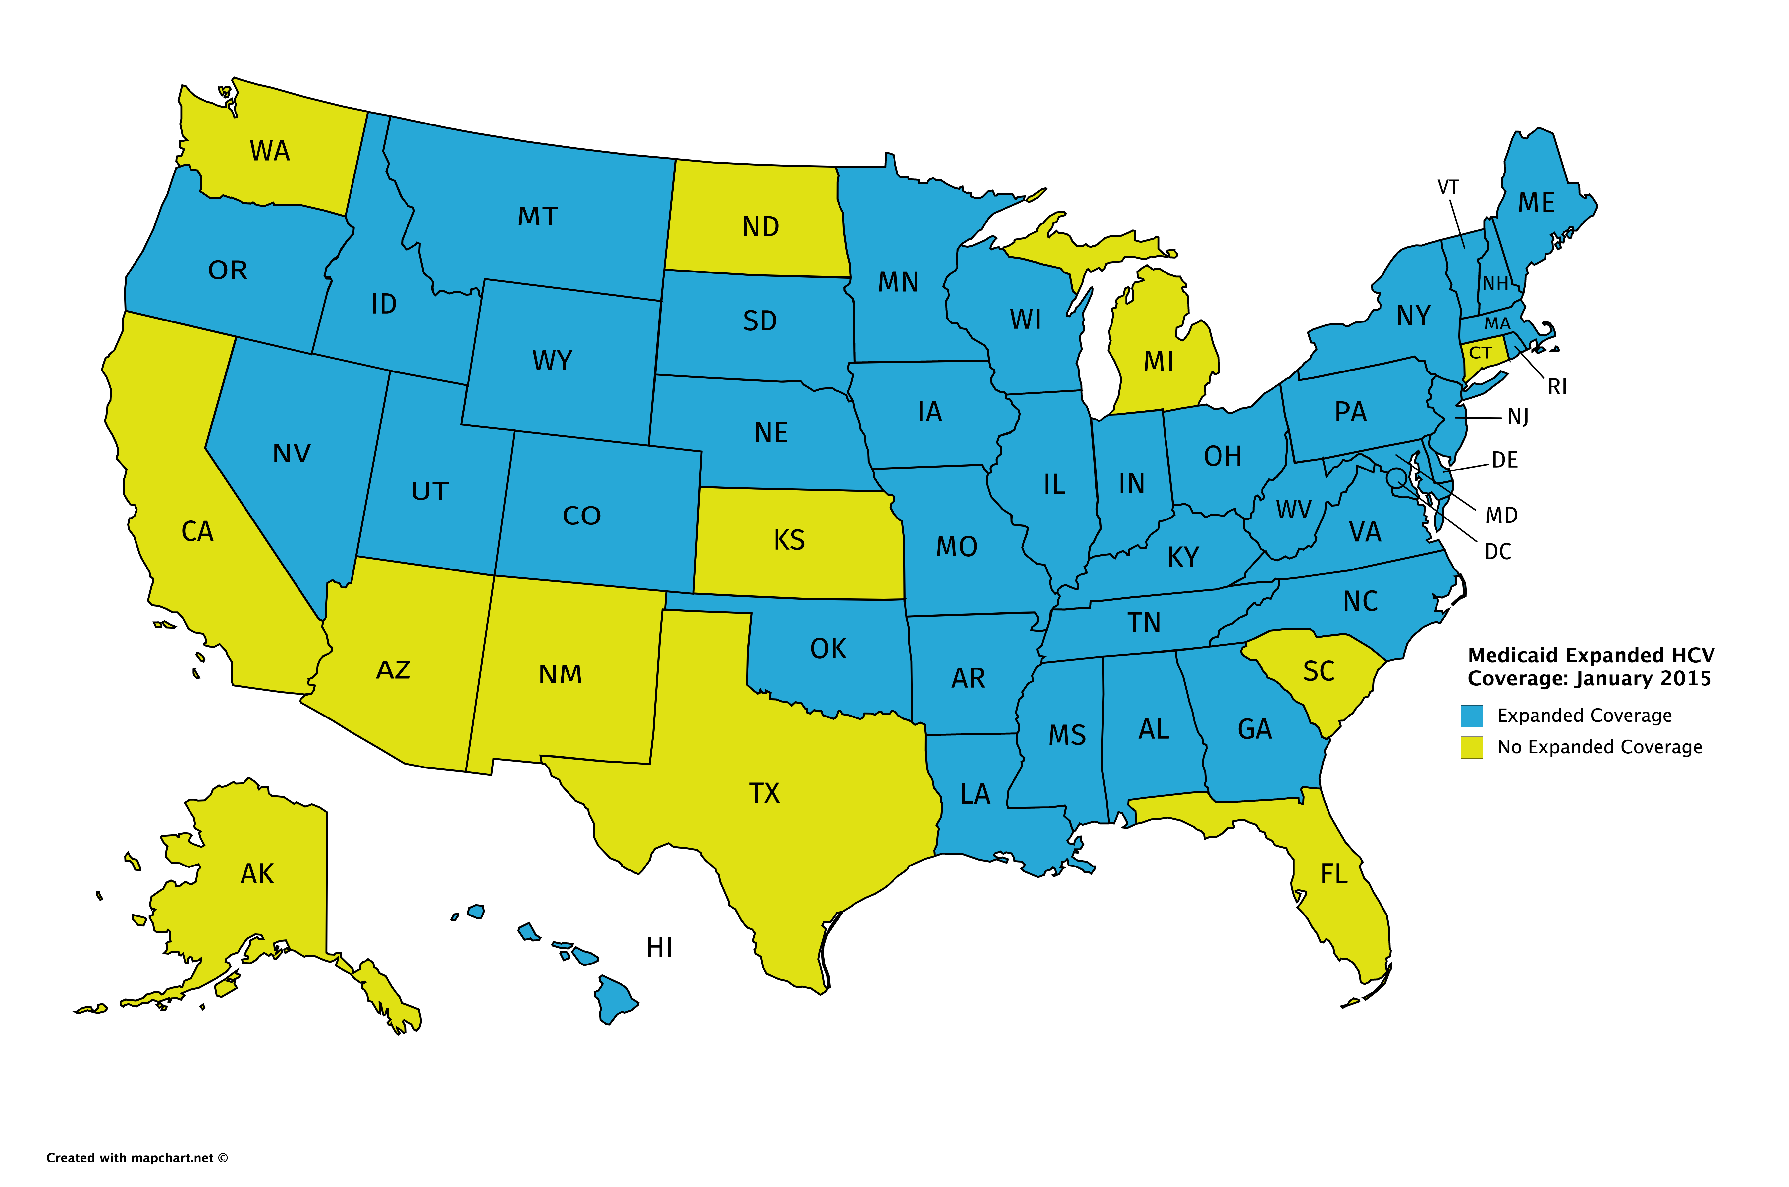
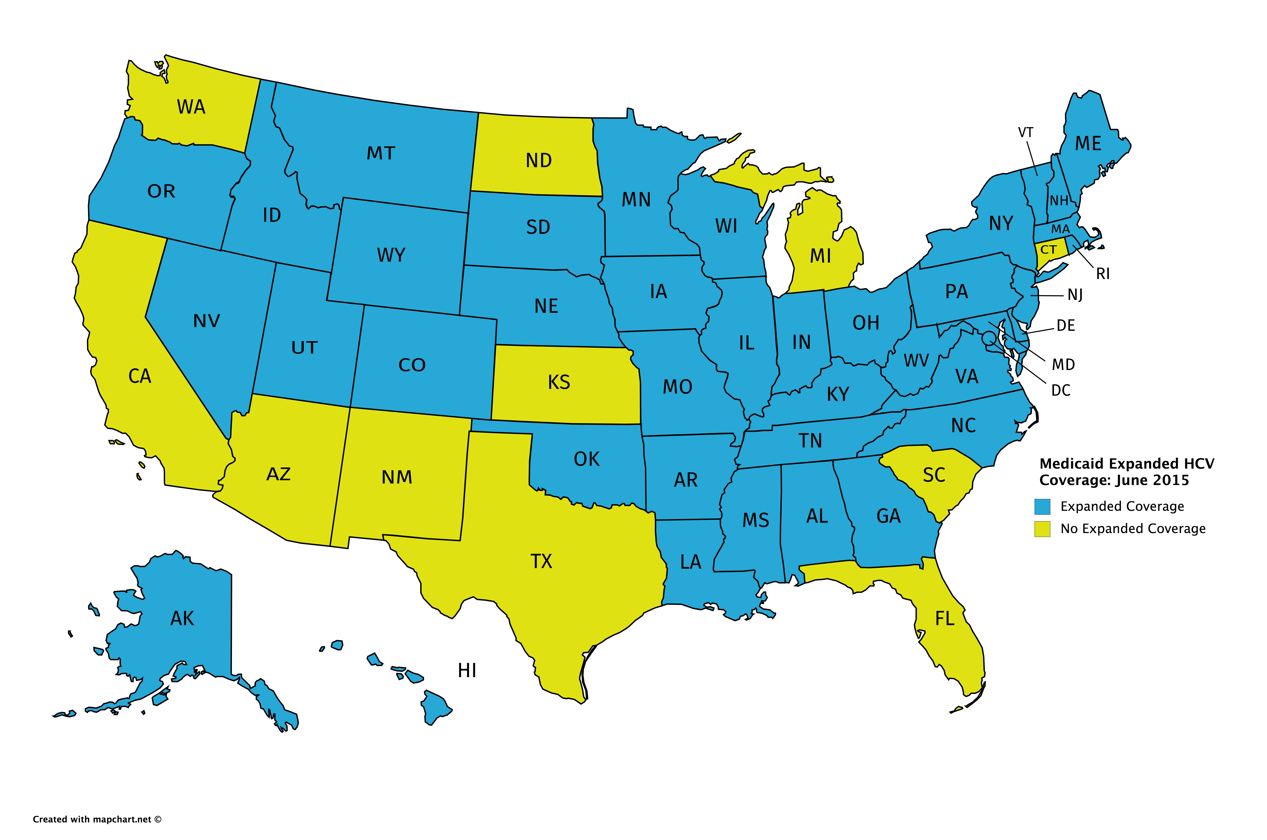
Medicaid Expanded Coverage:
January 2015 – June 2015

Slide 15
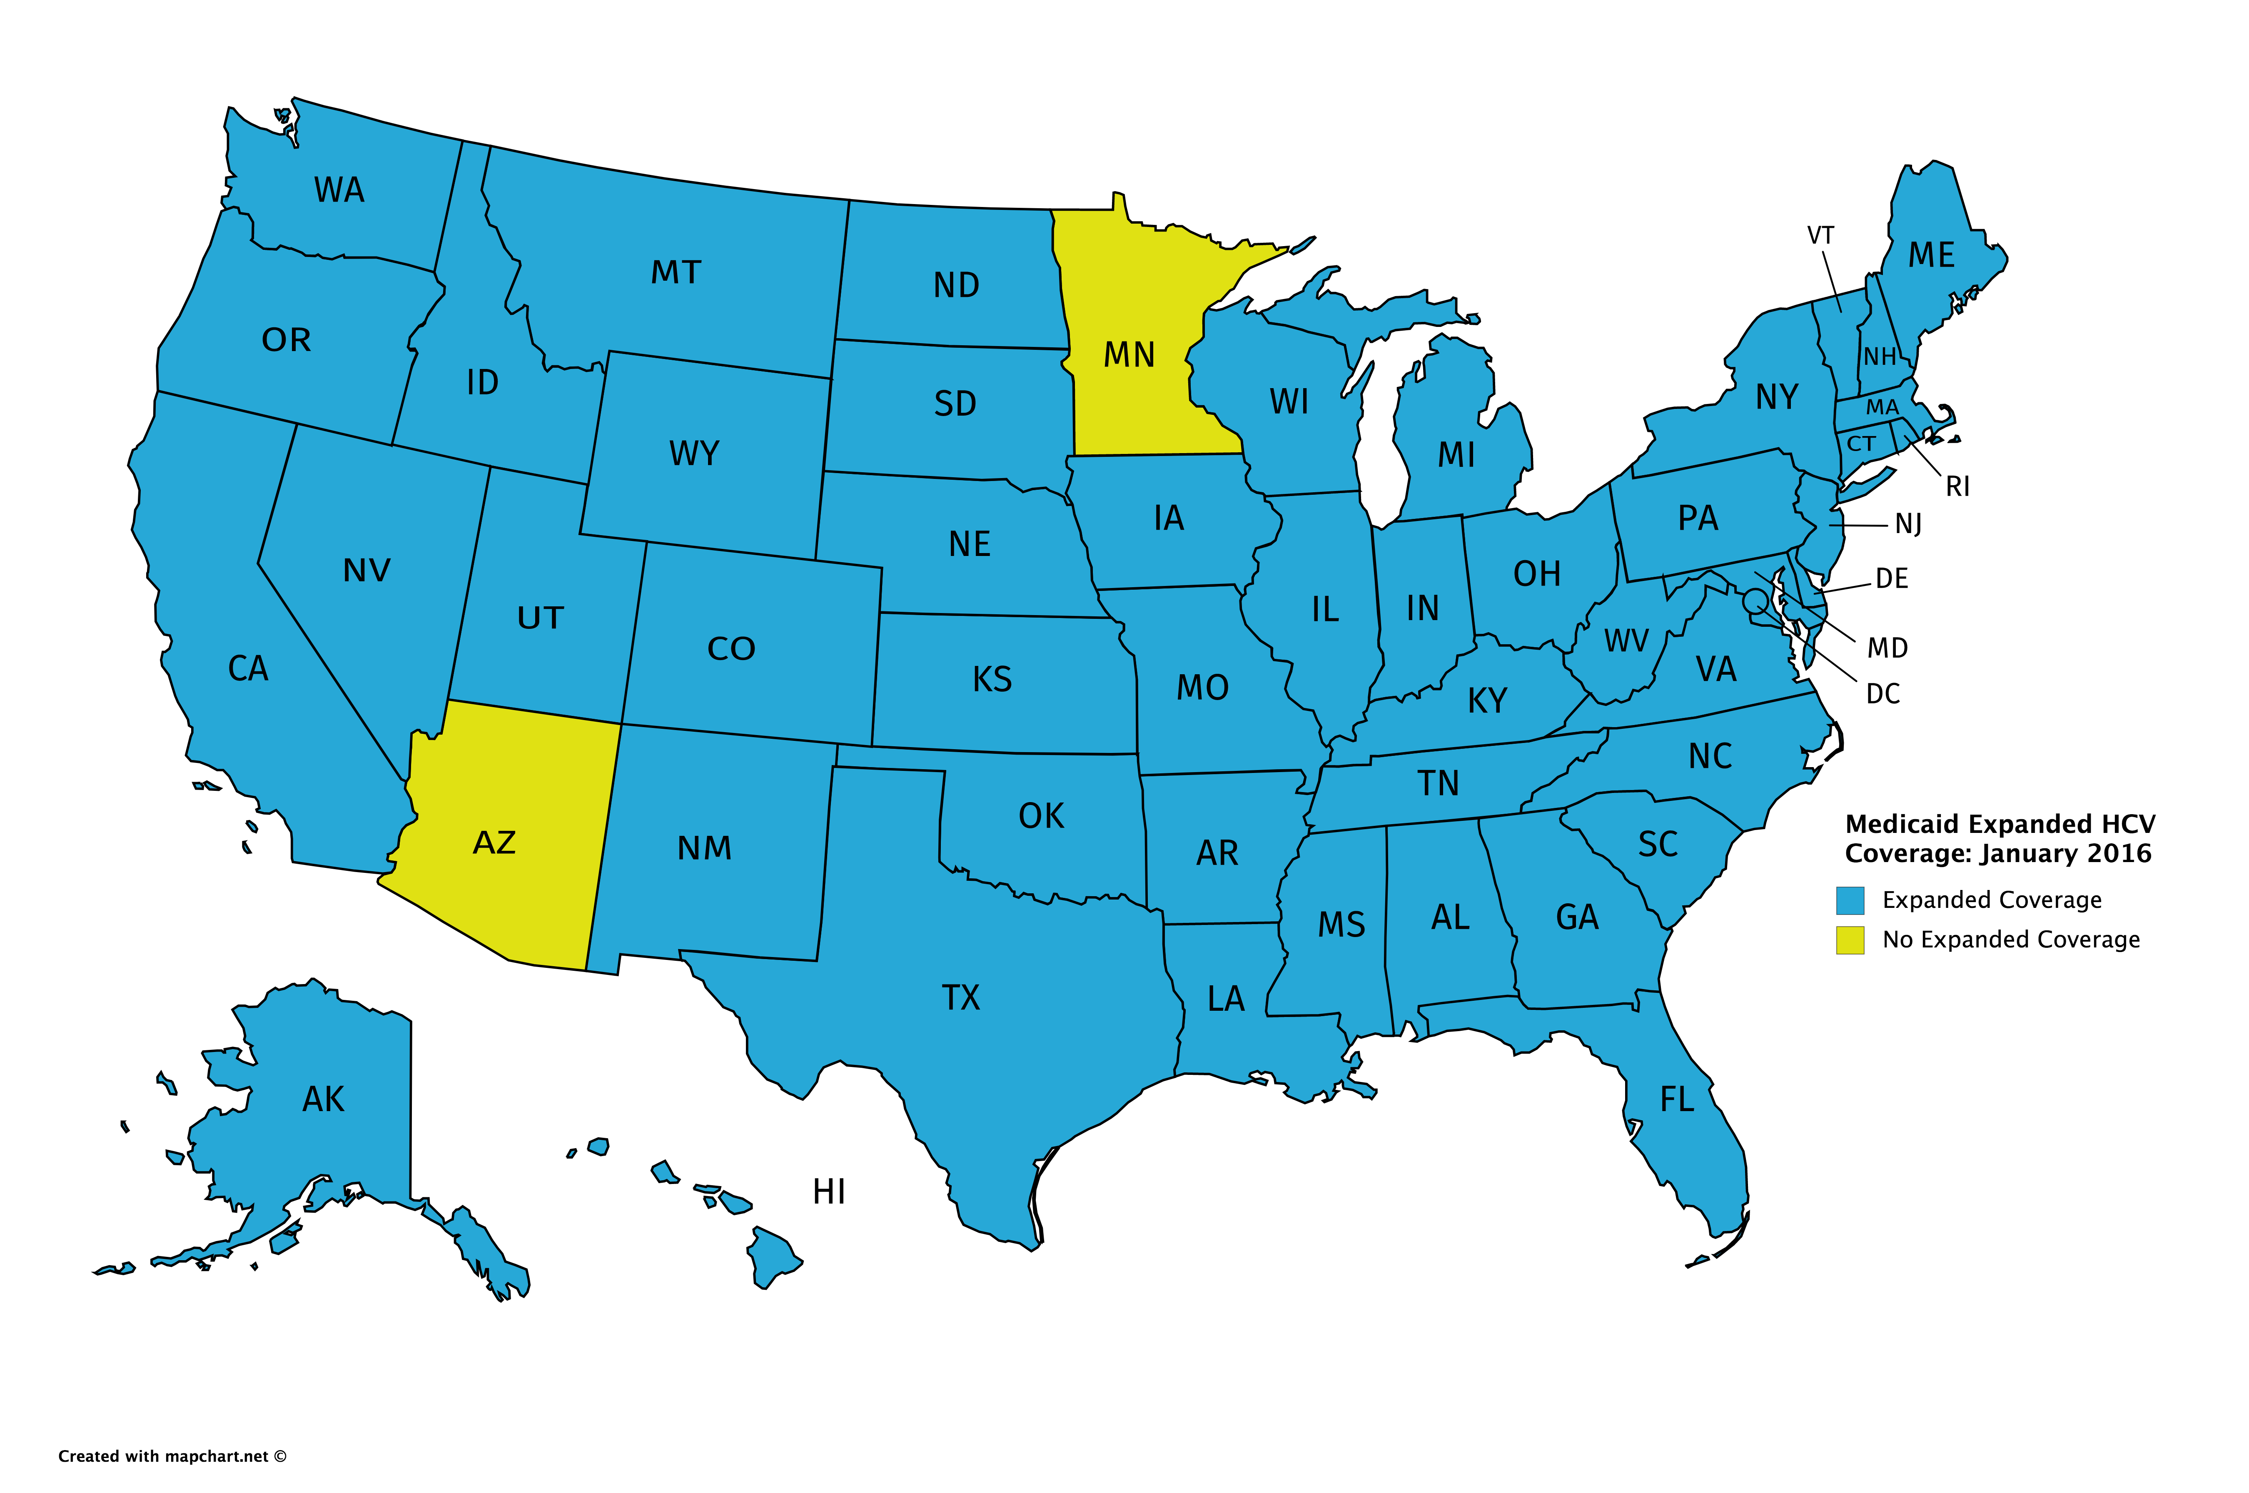
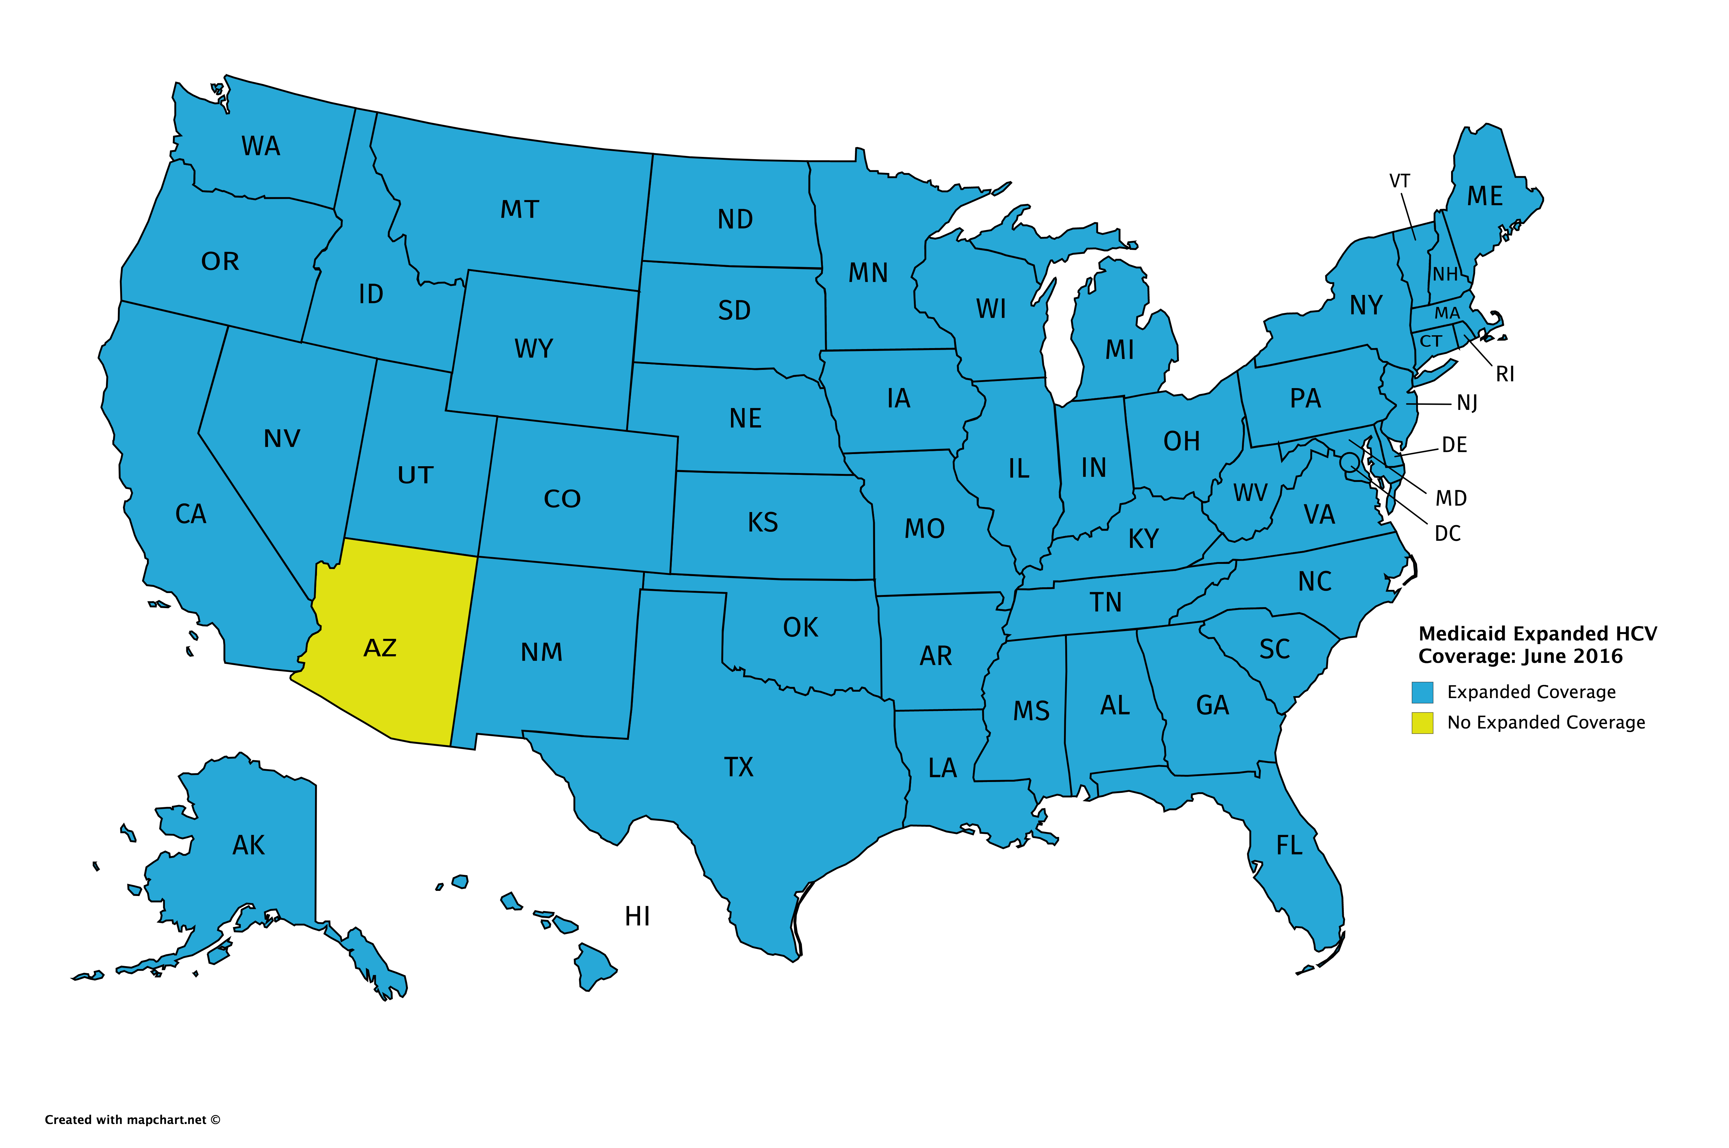
Medicaid Expanded Coverage:
January 2016 – June 2016

Slide 16
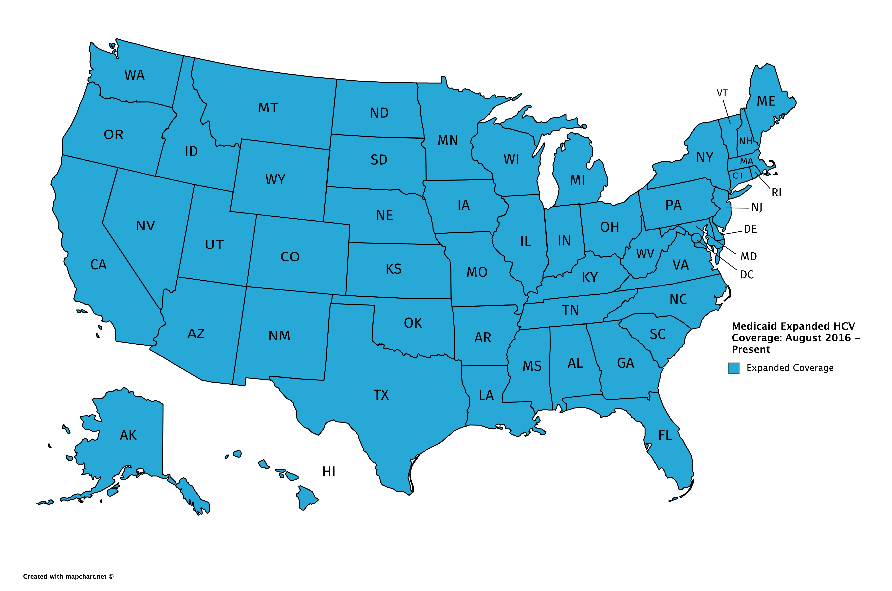
Medicaid Expanded Coverage:
August 2016 – Present

Slide 17
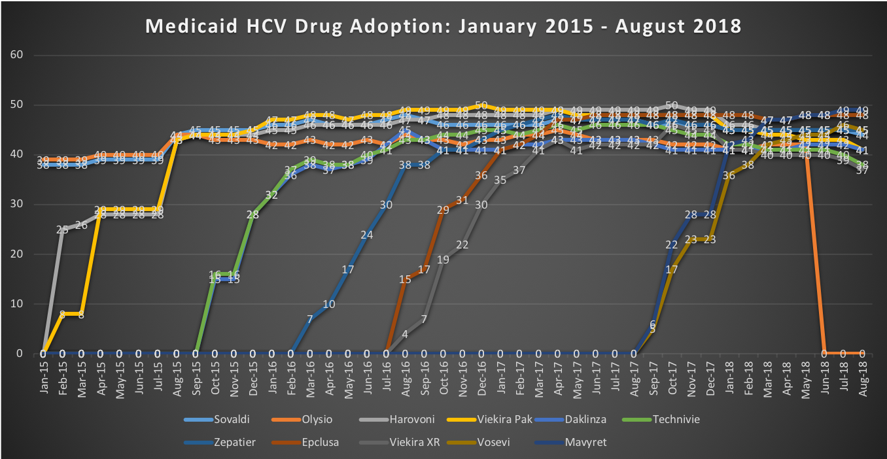
Medicaid HCV Drug Utilization:
January 2015 – August 2018

Slide 18
2018 Trends: Veterans Affairs
Coverage Trends:
  The Report began covering VA HCV coverage in March 2016
  Coincided with VA announcement of universal coverage for all eligible VA members
  Most-used drugs: Zepatier, Mavyret, Harvoni, Epclusa, Vosevi (in treatment experienced)
  VA continues to provide most effective treatment program in government-funded healthcare

Slide 19
2018 Trends: Harm Reduction
Syringe Services Programs (SSPs) being met with community/official backlash
  Scapegoating
  Anecdotal evidence held up as definitive proof
  Improper disposal/sharps waste concerns
  Questioning delivery models and record keeping
  Expecting immediate results

Slide 20
2018 Trends: Harm Reduction
Primary barriers to Harm Reduction Measures:
  Doctor Shopping:
    Federal blanket statute
    Reporting/Checking hassle
  Physical Exam Requirement:
    Physician/Pain Advocate opposition
    “Too time consuming”
    “Too onerous”
    Patient mobility/barriers to accessing care/treatment
  ID Requirement for Purchase of Prescription Opioid Drugs:
    Pain Advocate opposition
    “Burden on poor/minority patients”
    Hardware update costs for scanning
    “Government tracking”
  Prescriber Education:
    Physician opposition
    “Time consuming”
  Pharmacy Lock-In Programs:
    Outdated/User unfriendly software/interface
    Paid Advocate opposition – “Barrier to accessing care/treatment”

Slide 21
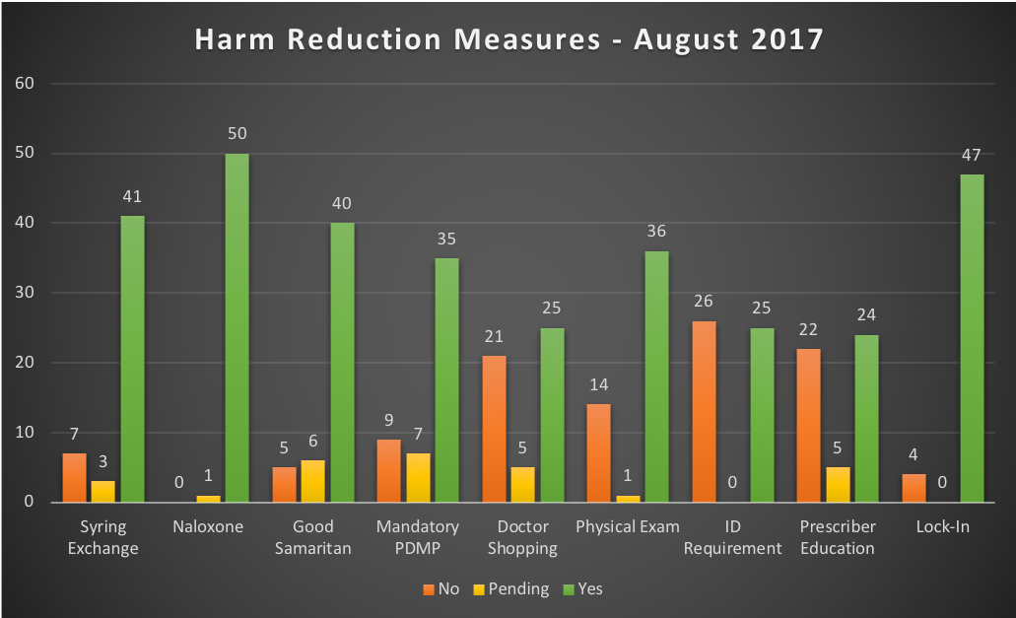
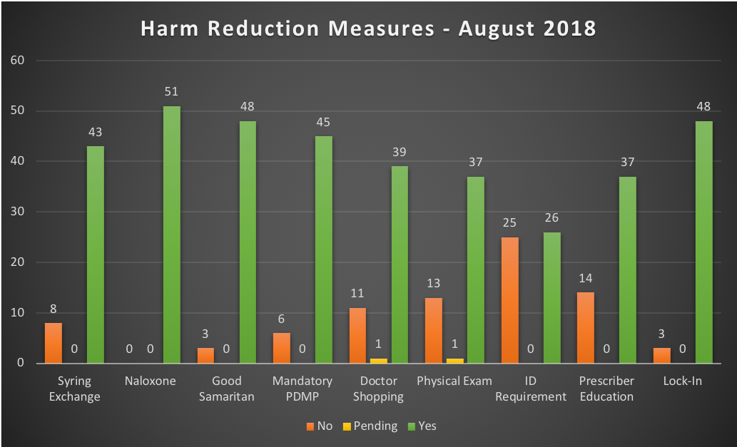
Harm Reduction Measures:
August 2016 vs. 2017

Slide 22
Viral Hepatitis in Correction Settings
Most state Departments of Corrections require or offer testing during intake
  27 for HBV
  35 for HCV (Figure 3.)
Most states fail to follow recommendations set for Federal Prisons
  Only 8 states use Opt-Out for HBV (MO, OH, OK, PA, TN, WA, WI, DC)
  Only 17 states use Opt-Out for HCV (CA, IL, IA, MA, MO, NH, OH, OK, PA, RI, SC, TN, VT, VA, WA, WI, DC)
Several states require inmates to be tested with no refusal possible
  3 states for HBV (CO, MO, & NE)
  6 states for HCV (CO, ID, IN, MO, NE, & OH)
Many test only on inmate request or based on Clinical Criteria
  25 for HBV (AK, AZ, CA, DE, GA, HI, ID, IL, IA, KY, MD, MA, MI, MN, MT, NM, ND, OH, OK, RI, TN, TX, UT, VA, WY, DC)
  20 for HCV (AK, AZ, DE, GA, HI, KY, MD, MA, MN, MT, NH NM, ND, OK, TN, TX, UT, VA, WY, DC)
States Facing HCV-Related Lawsuits:

Slide 23
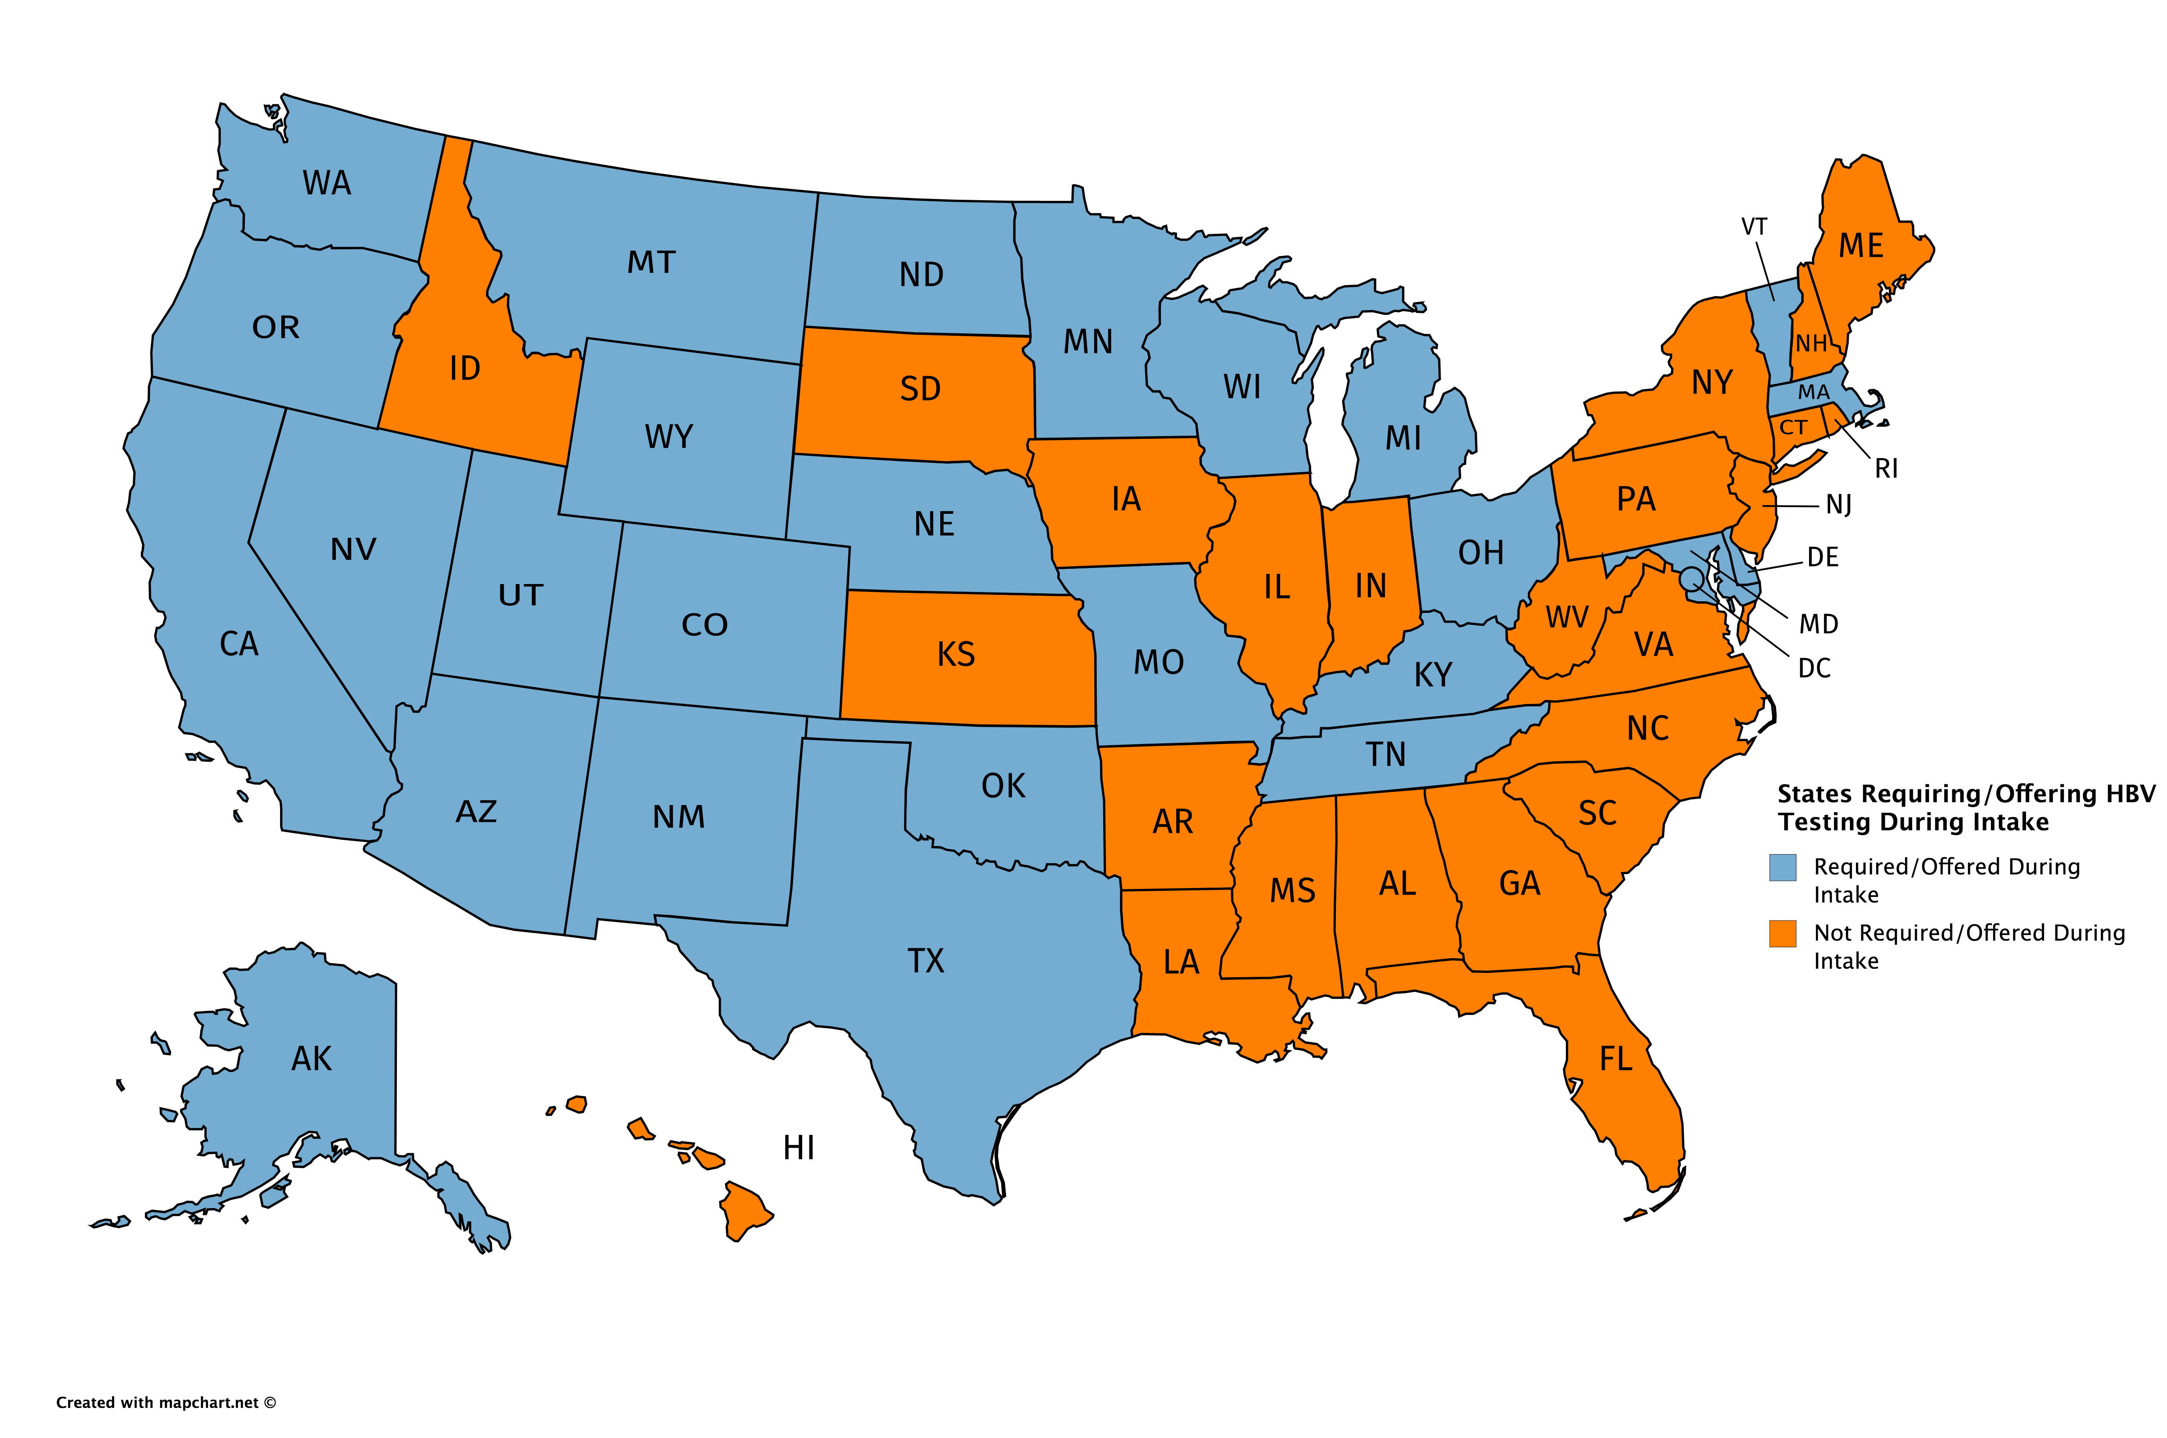
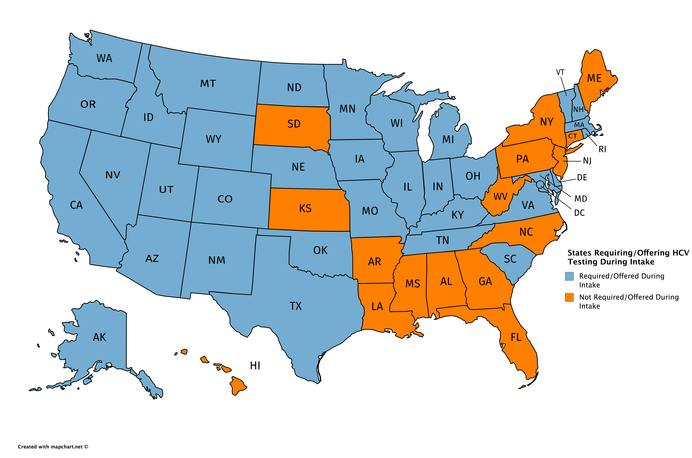
States Requiring/Offering HBV/HCV Testing During Intake

Slide 24
States with Ongoing HCV-Related Litigation (2017-2018)

Slide 25
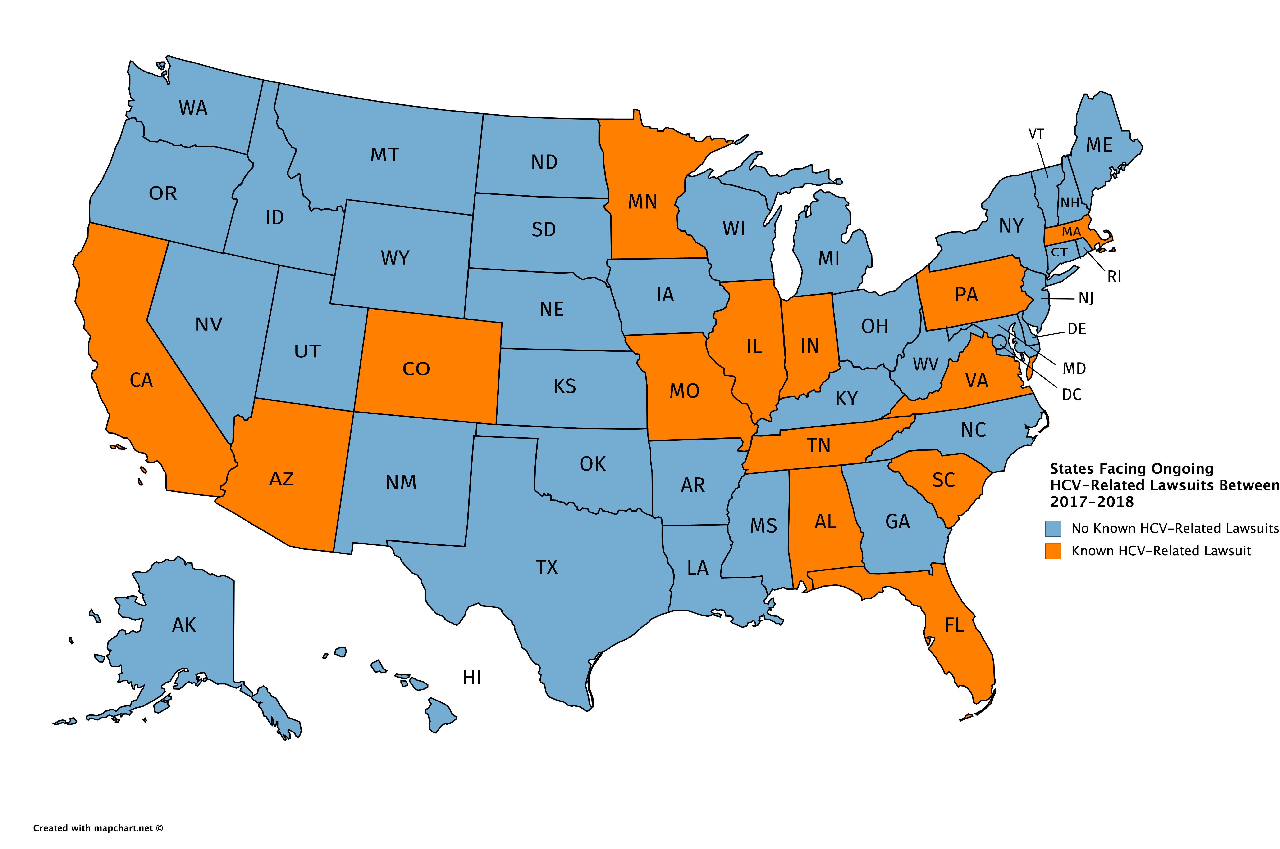
State/Federal HCV-Related Lawsuits (2017-2018)
At least 16 Class-Action and Civil Rights Action lawsuits were ongoing in 14 states between 2017-2018. (This graphic may not represent every suit filed at all levels)
Notes:
Map showing the following State AIDS Drug Assistance Programs covering HCV treatments: AL, AK, AZ, CA, CO, CT, DE, GA, HI, IL, IN, IA, LA, ME, MD, MA, MI, MN, MS, MO, NE, NH, NJ, NY, NC, OK, OR, PA, RI, SC, SD, TN, VA, WA, WV, WI, WY, DC, FM, PR.

Slide 26
Contact Information
Community Access National Network (CANN)
1724 Florida Avenue, NW
Washington, DC 20009
(202) 290-2019
www.tiicann.org
http://www.tiicann.org/co-infection-watch.html
Bill Arnold, President & CEO
weaids@tiicann.org
Marcus J. Hopkins, Project Director
mhopkins@tiicann.org

