Slide 1
Community Action National Network National 340B Commission Testimony of Sue Veer MBA President and CEO for Carolina Health Centers, Inc.
Tuesday, July 10, 2018

Slide 2
3 key areas where health center Program Expectation impact 340B Implementation
Charity Care
Health centers don’t have “charity care” programs – health centers provide access to care regardless of socio-economic barriers.
HRSA Oversight
Community health centers are under the oversight of HRSA, which approves our Scope of Project to which all Section 330 program requirements apply.
Health centers are expected to provide pharmacy services appropriate for their patients.
Health centers that offer pharmacy are required to participate in the 340B Program or a purchasing agreement that yields equal savings.
Charges and Savings
The 340B statute is silent on the issue of how much patients are charged but Section 330 is not: sliding fee discounts must apply to 340B prescriptions for eligible patients.
While the 340B statute does not mandate how savings are used, HRSA requires that 330 grantees and look-alikes reinvest all program revenues into activities that promote the purpose of their HRSA/BPHC Scope of Project.

Slide 3
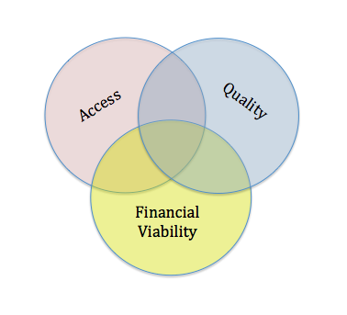
At the heart of the value proposition for the 340B Drug Pricing Program

Slide 4
Value
Low
Program Optimization
High

Slide 5
Strategic, operational, and compliance challenges and threats for the health center community
Responsibility and accountability as a Patient Centered Medical Home
340B eligibility across the continuum of care
Impact of access and adherence on outcomes-based performance measures
Scope of Project extending beyond the walls of physically distinct sites
Shift of margin to 3rd parties and intermediaries

Slide 6
Looking back at the storm that has gain momentum over the last 12-18 months, what are the common themes?
Health centers remain outside the center of the storm
Disproportionate focus on hospitals
Conflicting data and misguided association with rising drug costs
Consensus on need for additional regulatory authority
Intent of the program at question: a prescription assistance program versus mechanism to support the safety net mission of increased access to comprehensive services?
Strong appetite for reporting on amount and use of retained savings
Concern about 3rd parties in the supply chain

Slide 7
The Community Health Center advocacy message
We want Congress to have full confidence in the 340B program.
The intent of the program is to ensure the nation has a strong and effective health care safety net.
The 340B program helps us bend the cost curve in the right direction.
Increased regulatory authority is not inherently bad as long as rule-making:
Is sensitive to the unique characteristics of covered entity types;
Aligns with the patient centered medical home model; and
Preserves those aspects of the program that are proven to be effective.
Health centers have a long and successful history of accountability to HRSA for measurable performance outcomes and are willing and able to demonstrate the value of the 340B program; however,
The value of the 340B program cannot be measured by charity care alone … it is reflected in the myriad of programs and services that bring benefit to the communities we serve.

Slide 8
Community Benefit vs. Charity Care
330 deficit, other uncompensated care and operational losses
Community development and health improvement services
Subsidized health services – behavioral health counseling, adult oral health, controlled substance interventions
Free vaccinations
Free medication delivery to rural and remote areas
Otherwise unfunded pharmacy MTM and patient assistance services
Transitions of care teams that serve both insured and uninsured patients
Necessary but otherwise unfunded capital improvements that improve access to care
Bad debt

Slide 9
Thank you for your commitment to the integrity and effectiveness of the 340B Drug Pricing Program.
For questions and further assistance:
Sue Veer
President and CEO
Carolina Health Centers, Inc. sveer@carolinahealthcenters.org

