Slide 1
A Prescription for Manipulation?
Ex Ante Strategic Behavior in the 340B Program
ASHE 2018
Sayeh Nikpay, Ph.D., M.P.H.
Vanderbilt University School of Medicine
Melinda Buntin, Ph.D.
Rena Conti, Ph.D.

Slide 2

Do hospitals use 340B strategically?
Notes:
Thank sunita for setting up nicely

Slide 3
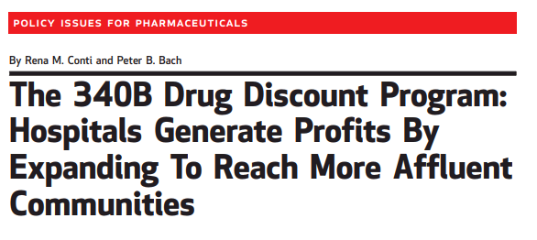

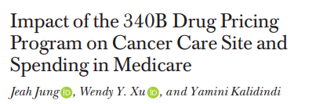
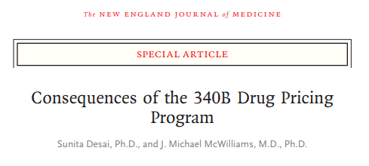

Evidence of ex post strategic behavior

Slide 4




Ex Ante strategic behavior is also likely
“Despite a concerted effort by the hospital’s internal accounting department, …[it] found that it had not identified a sufficient number of days to qualify for DSH payments. … [T]he hospital engaged HPS to conduct a review of the hospital’s data to assess their DSH opportunity”
Notes:
http://www2.dhgllp.com/industries/healthcare/hospital_healthcare_systems/DSHpro/ DSHPRO
http://www.healthcarepayment.com/solutions/dsh/ STINGRAY

Slide 5
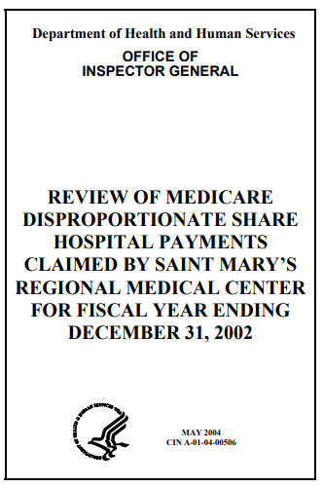
Ex Ante strategic behavior is also likely
Evidence from Accounting:
Hospitals manipulate total bed days to receive favorable DSH adjustment (Barnes and Harp 2017)
Hospitals manipulate adjusted DSH patient percentage to receive Medicare DSH payments (Barnes Buchheit and Parsons 2018)
Notes:
http://www2.dhgllp.com/industries/healthcare/hospital_healthcare_systems/DSHpro/ DSHPRO
http://www.healthcarepayment.com/solutions/dsh/ STINGRAY

Slide 6
Goal of our Study
Cross sectional, non-parametric tests for manipulation
Within-hospital, semi-parametric tests for manipulation
Hypothesize potential mechanisms

Slide 7

The DSH patient percentage
Unadjusted DSH Patient Percentage, D
$$D=\frac{SSI−Eligible Medicare Days}{Total Medicare Days}+\frac{Medicaid, Non−Medicare Days}{Total Patient Days}$$
Adjusted DSH Patient Percentage, A
$A=f(D, Total Bed Days, Urban Status)$

Slide 8
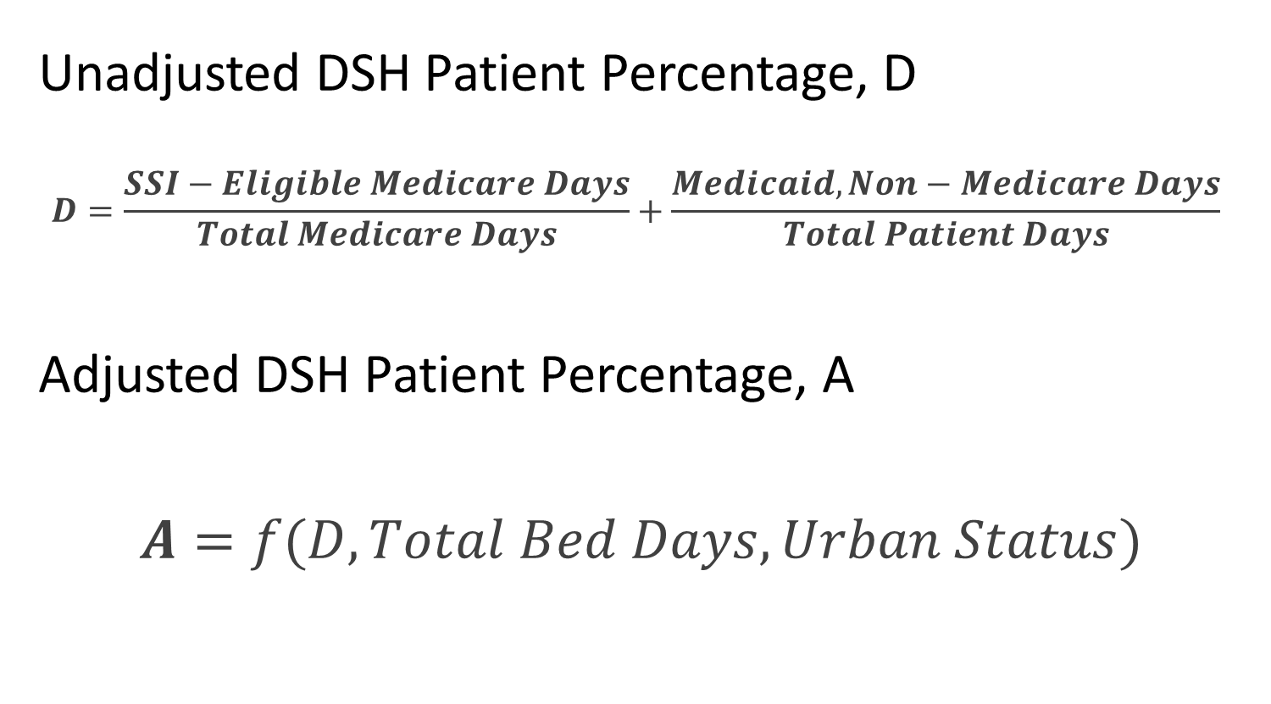
The DSH patient percentage
Unadjusted DSH Patient Percentage, D
$$D=\frac{SSI−Eligible Medicare Days}{Total Medicare Days}+\frac{Medicaid, Non−Medicare Days}{Total Patient Days}$$
Adjusted DSH Patient Percentage, A
$A=f(D, Total Bed Days, Urban Status)$

Slide 9
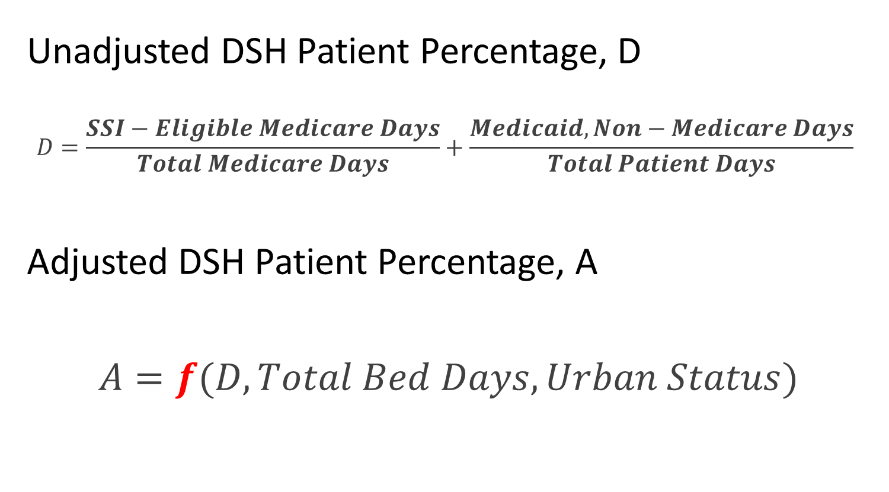
The DSH patient percentage
Unadjusted DSH Patient Percentage, D
$$D=\frac{SSI−Eligible Medicare Days}{Total Medicare Days}+\frac{Medicaid, Non−Medicare Days}{Total Patient Days}$$
Adjusted DSH Patient Percentage, A
$A=f(D, Total Bed Days, Urban Status)$

Slide 10
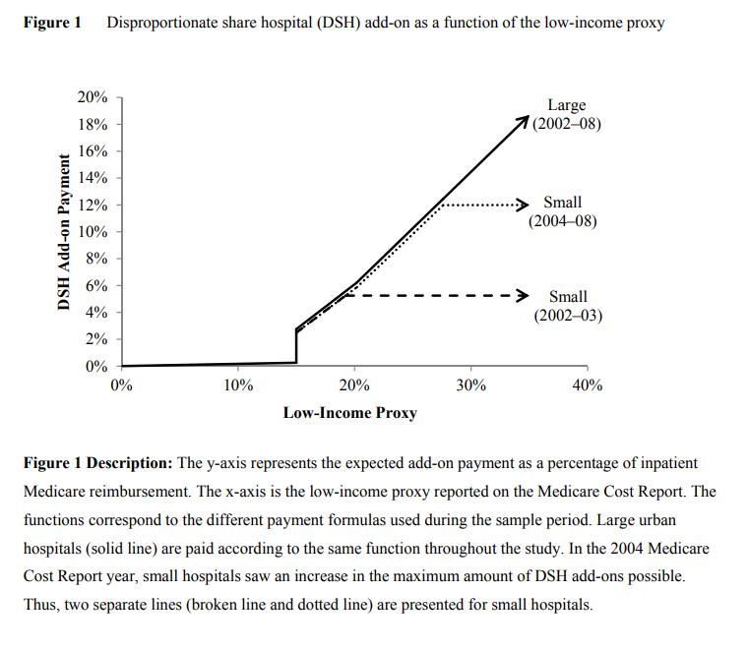
Changes in f across hospitals and over time
Urban, >100 Total Bed Days
Urban, <100 Total Bed Days, 2004+
Urban, <100 Total Bed Days, <2004
Re-printed from Barnes and Harp (2017)

Slide 11
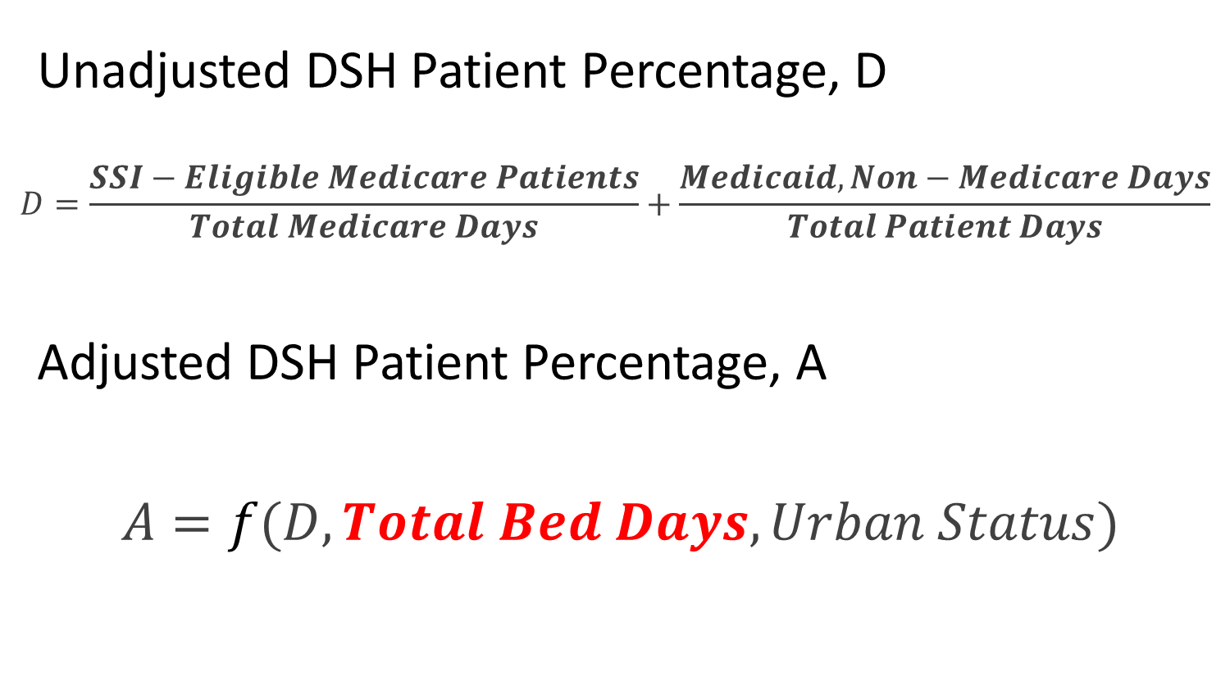
The DSH patient percentage
Unadjusted DSH Patient Percentage, D
$$D=\frac{SSI−Eligible Medicare Patients}{Total Medicare Days}+\frac{Medicaid, Non−Medicare Days}{Total Patient Days}$$
Adjusted DSH Patient Percentage, A
$A=f(D, Total Bed Days, Urban Status)$

Slide 12
Beds vs. Total Bed Days
Difference between Total Bed Days and Facility Beds

Slide 13
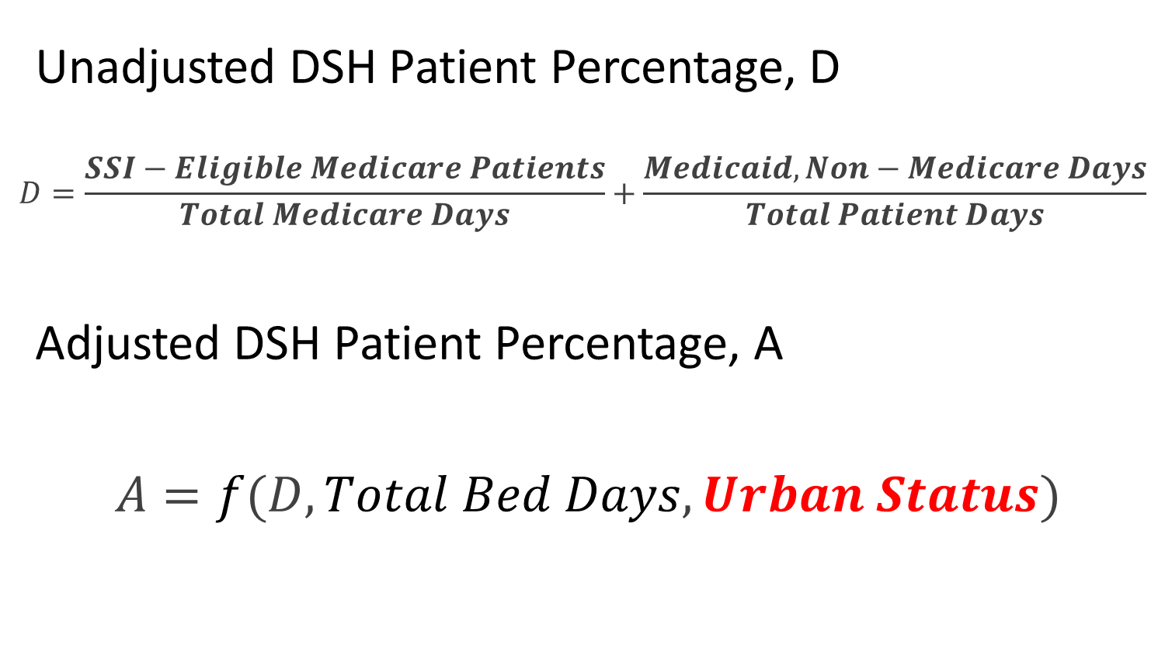
The DSH patient percentage
Unadjusted DSH Patient Percentage, D
$$D=\frac{SSI−Eligible Medicare Patients}{Total Medicare Days}+\frac{Medicaid, Non−Medicare Days}{Total Patient Days}$$
Adjusted DSH Patient Percentage, A
$A=f(D, Total Bed Days, Urban Status)$

Slide 14
Data and Sample Selection
Cost Reports + Medicare Impact Files: ‘96-’16
9,723 (N=151,072)

Slide 15
Data and Sample Selection
Cost Reports + Medicare Impact Files: ‘96-’16
- Hospital types other than general acute care
- For-profits
- Rural hospitals
- <140 Total Bed Days
- Special designations
- Irregular fiscal year
9,723 (N=151,072)
1,703 (N=13,587)

Slide 16
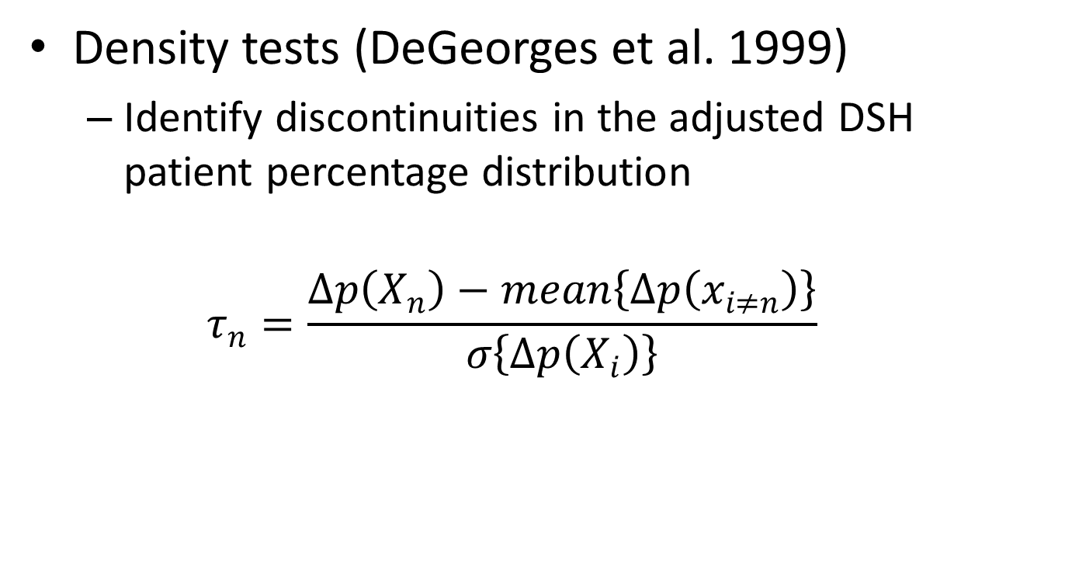
Cross-sectional, non-parametric test
Density tests (DeGeorges et al. 1999)
  Identify discontinuities in the adjusted DSH patient percentage distribution
  $$τ_{n}=\frac{Δp\left(X_{n}\right)−mean\left\{Δp\left(x_{i≠n}\right)\right\}}{σ\left\{Δp\left(X_{i}\right)\right\}}$$

Slide 17
Data and Sample Selection
Sample Hospitals
1,703 (N=13,587)

Slide 18
Data and Sample Selection
Sample Hospitals
1,703 (N=13,587)
340B Hospitals
- Started before 2000
769 (N=11,790)

Slide 19
Data and Sample Selection
Sample Hospitals
1,703 (N=13,587)
340B Hospitals
- Started before 2000
A₋₅ >11.75%
769 (N=11,790)
A₋₅ <11.75%

Slide 20
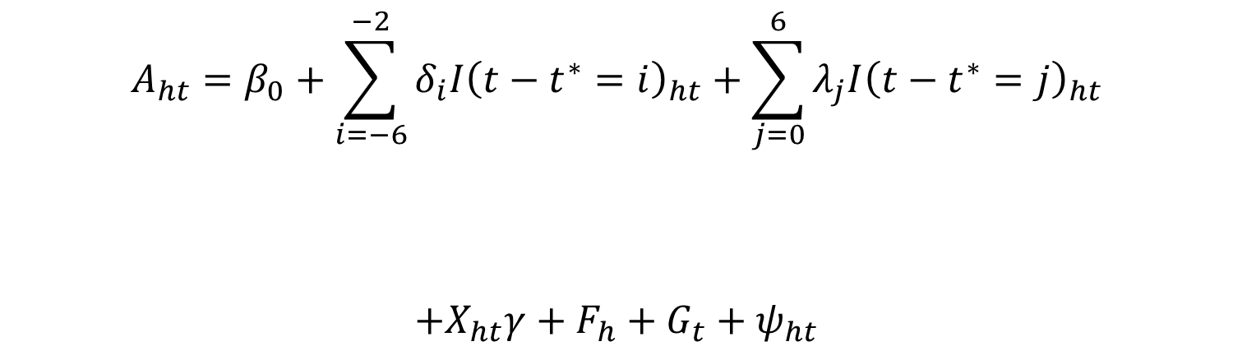
Within hospital, semi-parametric test
$$A_{ht}=β_{0}+\sum_{i=−6}^{−2}{δ_{i}I{\left(t−t^{∗}=i\right)}_{ht}}+\sum_{j=0}^{6}{λ_{j}I{\left(t−t^{∗}=j\right)}_{ht}}$$
$$+\sum_{i=−6}^{−2}{κ_{i}LOW×I{\left(t−t^{∗}=i\right)}_{ht}}+\sum_{j=0}^{6}{ξ_{j}LOW×I{\left(t−t^{∗}=j\right)}_{ht}}$$
$$+X_{ht}γ+F_{h}+G_{t}+ψ_{ht}$$

Slide 21
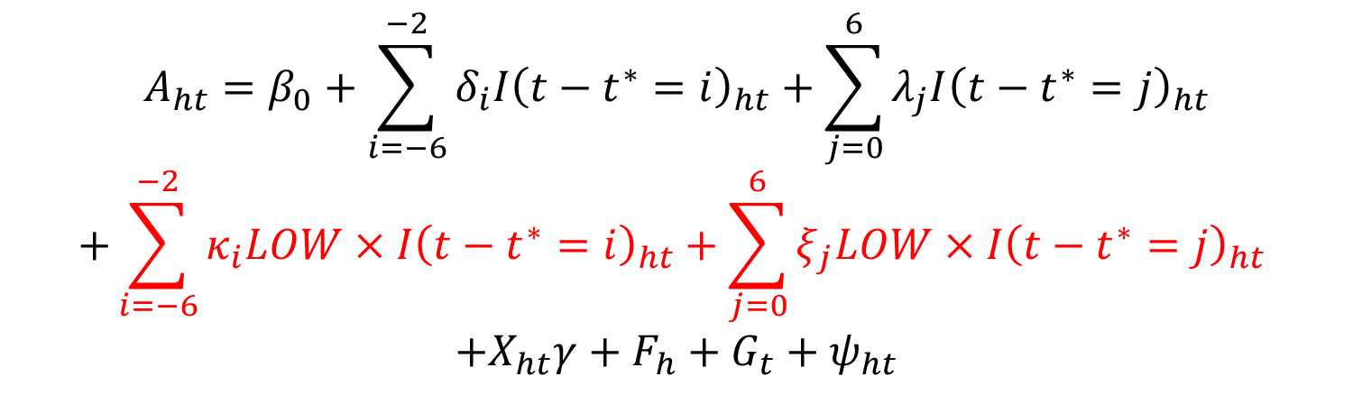
Within hospital, semi-parametric test
$$A_{ht}=β_{0}+\sum_{i=−6}^{−2}{δ_{i}I{\left(t−t^{∗}=i\right)}_{ht}}+\sum_{j=0}^{6}{λ_{j}I{\left(t−t^{∗}=j\right)}_{ht}}$$
$$+\sum_{i=−6}^{−2}{κ_{i}LOW×I{\left(t−t^{∗}=i\right)}_{ht}}+\sum_{j=0}^{6}{ξ_{j}LOW×I{\left(t−t^{∗}=j\right)}_{ht}}$$
$$+X_{ht}γ+F_{h}+G_{t}+ψ_{ht}$$

Slide 22
Within hospital, semi-parametric test
$$A_{ht}=β_{0}+\sum_{i=−6}^{−2}{δ_{i}I{\left(t−t^{∗}=i\right)}_{ht}}+\sum_{j=0}^{6}{λ_{j}I{\left(t−t^{∗}=j\right)}_{ht}}$$
$$+\sum_{i=−6}^{−2}{κ_{i}LOW×I{\left(t−t^{∗}=i\right)}_{ht}}+\sum_{j=0}^{6}{ξ_{j}LOW×I{\left(t−t^{∗}=j\right)}_{ht}}$$
$$+X_{ht}γ+F_{h}+G_{t}+ψ_{ht}$$
$$κ_{−6}<κ_{−5}<κ_{−4}<κ_{−3}<κ_{−2}<0$$

Slide 23
The adjusted DSH patient percentage in the year of participation has fallen
Median Adjusted DSH PP
in first year of participation

Slide 24
After 2010 at least half of new participants would not have qualified 3 years before
Median adjusted DSH PP
in first year of participation
Median adjusted DSH PP
3 years prior to participating

Slide 25
Hospitals disproportionally likely to locate just above 11.75 in 2006, 2016
Cross-sectional, non-parametric results

Slide 26
Hospitals disproportionally likely to locate just above 11.75 in 2006, 2016
Cross-sectional, non-parametric results
1st
3rd
~30 more hospitals
~40% increase

Slide 27
Hospitals disproportionally likely to locate just above 11.75 in 2006, 2016
Cross-sectional, non-parametric results

Slide 28
Hospitals disproportionally likely to locate just above 11.75 in 2006, 2016
Cross-sectional, non-parametric results
Actual adjusted DSH PP reported
to CMS 2011-2016

Slide 29
The ADSH PP is rising 5 years before participating, only for ineligible hospitals
Within-hospital, semi-parametric results

Slide 30

The ADSH PP is rising 5 years before participating, only for ineligible hospitals
Within-hospital, semi-parametric results
$κ_{−6}<κ_{−5}<κ_{−4}<κ_{−3}<κ_{−2}$ p<0.001

Slide 31
The ADSH PP is rising 5 years before participating, only for ineligible hospitals
Within-hospital, semi-parametric results
1.56 p.p. (S.E.=0.4)
~66% increase
0.01 p.p. (S.E.=0.6)

Slide 32
Components are also rising, especially Medicaid, non-Medicare part
Within-hospital, semi-parametric results

Slide 33
Components are also rising, especially Medicaid, non-Medicare part
Within-hospital, semi-parametric results
2.19 p.p. (S.E.=0.3)
0.39 p.p. (S.E.=0.4)

Slide 34
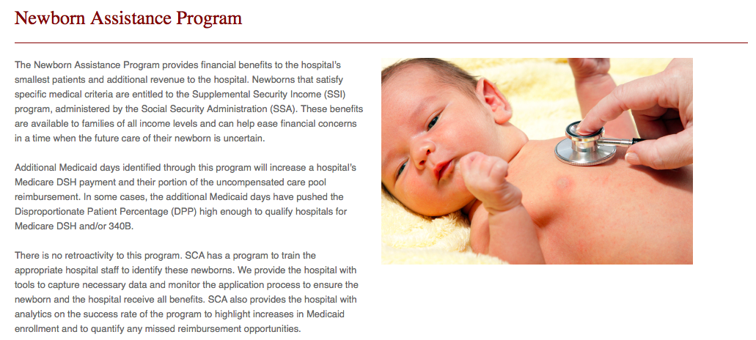
Possible Mechanisms
 “profitable” Medicaid care
In some cases the additional Medicaid days have pushed the DSH PP high enough to qualify hospitals for … 340B

Slide 35
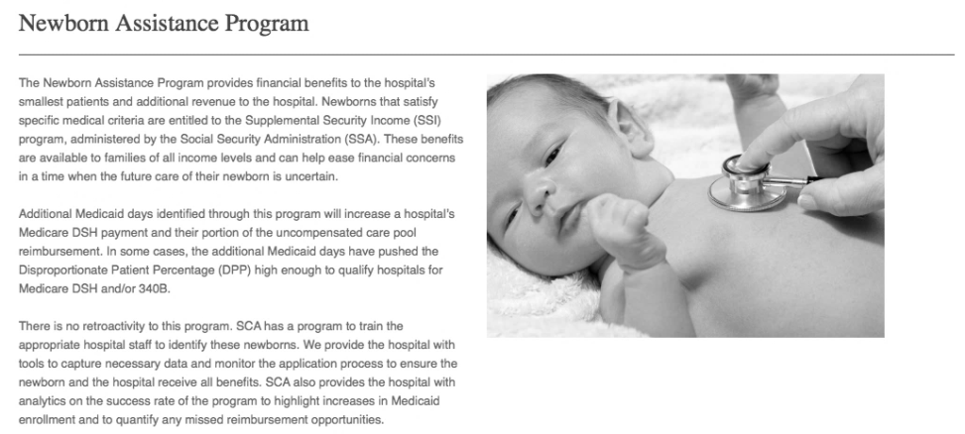
Possible Mechanisms
 “profitable” Medicaid care
Reclassify visits after the fact
Employ consultants to optimally recode data
In some cases the additional Medicaid days have pushed the DSH PP high enough to qualify hospitals for … 340B

Slide 36
Among low DSH hospitals, no differential investment in Labor & Delivery

Slide 37
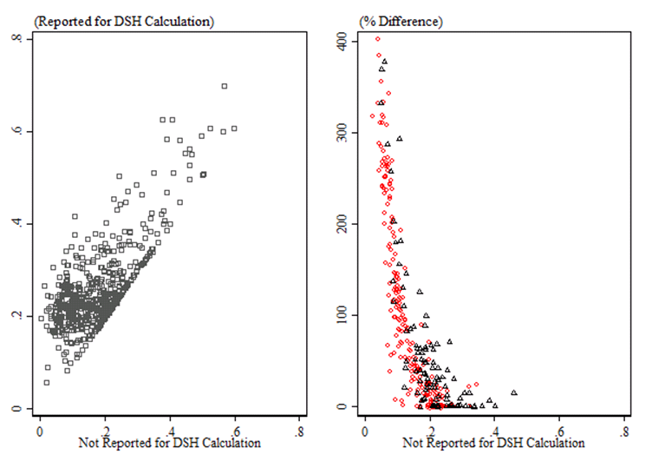
Medicaid day fraction is higher when reported for DSH adjustment than statistical purposes

Slide 38
Low vs. High DSH: Medicaid Volume
1.06 p.p. (S.E.=0.5)

Slide 39
Robustness tests
Include urban hospitals with 100-139 beds
Include hospitals with pre-period adjusted DSH patient percentages between 11.75 and 15% in high DSH group
Limit to a balanced panel
Use reported adjusted DSH patient percentages
All regression results are robust to differential Medicaid expansion

Slide 40
Summary
Hospitals with consistent, uncapped DSH adjustment formulas disproportionately locate just above the eligibility threshold
Adjusted DSH patient percentage increases by 1.6 p.p. per year more among hospitals below vs. above the cutoff 5 years before
Relative increase does not continue after gaining eligibility
Manipulation seems to occur through accounting after-the-fact rather than investment in new services

Slide 41
Implications for the literature
Observed effect = Treatment + Selection
Selection bias is non-trivial and precludes RD
We link literatures on strategic hospital behavior
Economics (Duggan 2001; Dafny 2003; Kessler and McClellan 1999, 2001; Eggleston et al. 2006)
Accounting (Barnes Buccheit and Parsons 2017; Barnes and Harp 2017; DeGeorges Patel and Zeckhauser 1999)

Slide 42
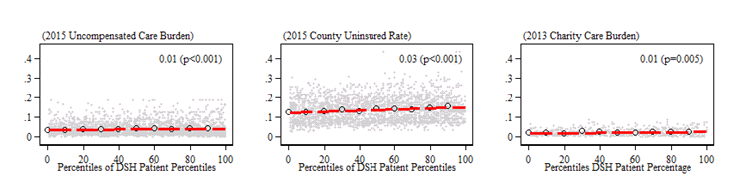
Policy Implications
Congress should consider changing eligibility criteria
DSHPP poor measure of care to 340B target population
Adjustments out-of-date: Medicaid population has tripled since 1992

Slide 43
Thank you!
Sayeh.s.nikpay@vanderbilt.edu
@saynikpay

Slide 44
Positive DSH pre-trends for hospitals below cutoff but not above

Slide 45
Positive DSH pre-trends for hospitals below cutoff but not above
LOW DSH
HIGH DSH

